Slide 1
Tobacco Licensing and Compliance with The Alcoholic Beverage Control Division.

Slide 2
Tobacco Application and its Requirements for a Retail License
Name of the Applicant.
Doing Business As name.
Name of Contact and Phone Number.
Mailing Address.
Physical Address.
State whether applicant is an LLC, Corporation, Partnership, or Individual.
If applicant is an LLC, Corporation, or Partnership, must state the date the entity was formed and registered with the New Mexico Secretary of State along with its address.
If applicant is an LLC, Corporation, or Partnership, Resident Agent application is required along with a copy of the ID of the appointed.
A map showing the distance from the requested license premise to the nearest school. (if less that 300 feet, license will be denied.)
A copy of the Business License.
A Zoning Letter of approval from the local governing body (City, County, or Village) allowing the sales of Tobacco.
A copy of the New Mexico Taxation and Revenue Department Business Tax Registration Certificate and ID.
A Listing of Manufactures and/or Distributors who supply the Tobacco Products including their full DBA, address, and phone number or email address.
Application must be Notarized

Slide 3
Tobacco Application and the Requirements for a Manufacturer License
Name of the Applicant.
Doing Business As name.
Name of Contact and Phone Number.
Mailing Address.
Physical Address.
State whether applicant is an LLC, Corporation, Partnership, or Individual.
If applicant is an LLC, Corporation, or Partnership the date the entity was formed with the new Mexico Secretary of State and registered along with its address.
A map showing the distance from the requested license premise to the nearest school. (if less that 300 feet, license will be denied.)
A copy of the Business License.
A Zoning Letter of approval from the Local Option District (City, County, or Village) allowing the sales of Tobacco.
A copy of the New Mexico Taxation and Revenue Department Business Tax Registration Certificate and ID.
Letter of Good Standing from the New Mexico Taxation and Revenue Department.
A Listing of Retailers and Distributors who purchase the manufactured Tobacco Products including their full DBA, address, and phone number or email address.
If only Manufacturing Cigarettes or Loose Tobacco, New Mexico Office of Attorney General Certificate of Compliance.
Application must be Notarized.
If applicant is an LLC, Corporation, or Partnership, Resident Agent application is required along with a copy of the ID of the appointed.

Slide 4
Tobacco Application and its Requirements for a Distributor License
Name of the Applicant.
Doing Business As name.
Name of Contact and Phone Number.
Mailing Address.
Physical Address.
State whether applicant is an LLC, Corporation, Partnership, or Individual.
If applicant is an LLC, Corporation, or Partnership the date the entity was formed and registered with the New Mexico Secretary of State along with its address.
If applicant is an LLC, Corporation, or Partnership, Resident Agent application is required along with a copy of the ID of the appointed.
A map showing the distance from the requested license premise to the nearest school. (if less that 300 feet, license will be denied.)
A copy of the Business License.
A Zoning Letter of approval from the Local Option District (City, County, or Village) allowing the sales of Tobacco.
A copy of the New Mexico Taxation and Revenue Department Business Tax Registration Certificate and ID.
Letter of Good Standing from the New Mexico Taxation and Revenue Department.
A Listing of Retailers and Manufactures who Tobacco Products are distributed to and from including their full DBA, address, and phone number or email address.
Application must be Notarized.

Slide 5
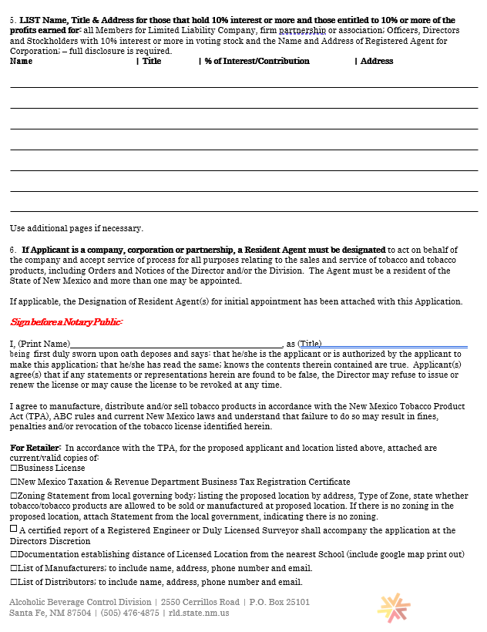

Slide 7
Resident Agent Application

Slide 8
Where can information be found regarding Tobacco Licensing?
Information can be obtained by calling our office on our main telephone line at 505-476-4875, asking to speak to Kyla Larsen or Angel Ruybal or by calling/emailing them directly.
Kyla Larsen: 505-476-4542 / Kyla.Larsen@rld.nm.gov
Angel Ruybal: 505-476-4544 / Angel.Ruybal2@rld.nm.gov
On the Alcoholic Beverage Control Divisions website at:
https://www.rld.nm.gov/abc/tobacco-licensing/

Slide 9
Current License Count with New Mexico Alcoholic Beverage Control Division
1,544 Active Retail Licenses
9 Active Manufacturer Licenses
48 Active Distributor Licenses
24 Pending Retail License Applications
4 Pending Manufacturer License Applications
22 Pending Distributor License Applications

Slide 10
Tutorial to Tobacco Section of Alcoholic Beverage Control Division

Slide 12
Application & Posters Page

Slide 13
Posted Poster

Slide 14
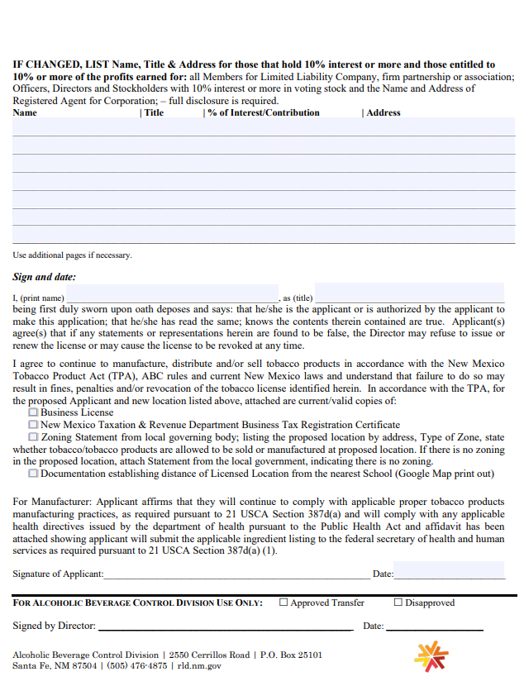
Tobacco License TRANSFER OF LOCATION Application and its requirements.

Slide 15
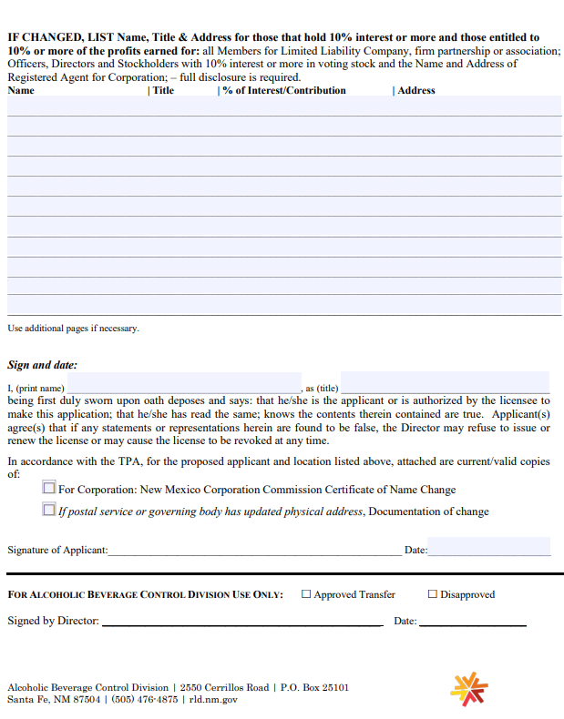
Tobacco License NOTICE of CHANGE Application and its requirements

Slide 16
Who can Investigate complaints, Issue Citations & Conduct Inspections?
State Police - Special Investigations Unit (S.I.U.) is the leading compliance check point and can/will issues Citations that are filed Administratively, Criminally, or both.
Alcoholic Beverage Control Division
The appropriate law enforcement authorities in each county and municipality
Criminal citations are processed through the Court systems
Administrative citations will be processed by Alcoholic Beverage Control Division’s Citations Manager, Beverly Kennedy, who can be reached at 505-476-4555 or Beverly.Kennedy@rld.nm.gov

Slide 17
Filing Complaints & Their Process
A formal complaint may be filed with the Alcoholic Beverage Control Division.
Complaint will be forwarded to State Police, SIU for investigation.
Complaint forms are listed on the Alcoholic Beverage Control Division’s website at Complaint Form (rtsclients.com)

Slide 18
Complaint Form

Slide 19
What Activities are Grounds for a Citation?
Unlicensed Sale by Non-licensees
Unlicensed Sale by License
Sales to Minors
Failure to Verify Age
Minors in Age-Controlled Locations
Sales of Tobacco Products not in Original Sealed Package
Sale of Tobacco Products not in Child-Resistant Packaging
Sale of Tobacco Products Knowingly Attractive to Minors
Providing Free Samples

Slide 20
Penalties for Violation of Sales to Minor
First Violation-Imposition of a one-day suspension and $1,000.00 fine
Second Violation at a location within three years of the first such violation-Imposition of a seven-day suspension and $4,000.00 fine
Third Violation at a location within three years of the first such violation-imposition of a thirty-day suspension and a $7,000.00 fine
Generally, after a fourth violation at a location within three years of the first such violation, permanent revocation of the licensee's license will be imposed.

Slide 21
Penalties for all other Violations Involving Minors
Generally, after a first violation at a location, imposition of a $1,000.00 fine
Second Violation at a location within three years of the first such violation-Imposition of a one-day suspension and $2,000.00 fine
Third Violation at a location within three years of the first such violation-imposition of a seven-day suspension and a $5,000.00 fine
Generally, after a fourth violation at a location within three years of the first such violation, imposition of a fourteen-day suspension and a $10,000 fine.

Slide 22
Penalties for Non-Age Specific Violations
Generally, after a first violation at a location-imposition of $100.00 fine
Generally, after a second violation at a location within three years of the first such violation-imposition of a $200.00 fine
Generally, after a third violation at a location within three years of the first such violation-imposition of a $400.00 fine
Generally, after a fourth violation at a location within three years of the first such violation-imposition of a $750.00 fine

Slide 23
SIU Surveillances and Investigation
Whether it is a scheduled operation for Sales to Minor, or when SIU opens and investigation from a complaint received from another Agency or the General Public, SIU conducts surveillance on behalf of ABC.
They have scheduled and random inspections that can lead to additional surveillance of the establishment. If a violation is found, it is the Agents prerogative to cite the Establishment, give them warning, or issue both criminal and/or Administrative Citations.
For Underage Operations, Minor Operative is sent in with cash and ID only, with minimal makeup, no hat or sunglasses, and cannot lie or persuade the clerk to sell them the product. Their Vertical ID with Date of Birth in RED showing that they are under 21 years of age is shown if asked.

Slide 24
Citation Process
If the Agent issues an Administrative Citation, it is filed with ABC along with the Incident Report and any supporting documentation. From incident date to filing of the Citations generally takes up to 6 weeks. SIU submits the case files electronically to ABC.
Upon receipt, the Case File is prepared, the documents reviewed and printed, evidence is analyzed, and if violations are established then a proposed settlement Agreement is drawn up and presented to the Establishment.
Upon review by ABC, if required evidence has not been provided and/or the citation is deficient, then the Citation is Dismissed or Reduced to a Warning with Notice served to the SIU Commander, Agent, and the Licensee.

Slide 25
Citation Process (Continued)
The Establishment has 30 days to respond and upon acceptance, they are allotted time to pay the Fine and serve the suspension date, if applicable. The instructions and Poster are provided to the Licensee prior to the suspension date. Once served, the licensee must provide the Daily Receipts and photographic evidence that the Poster was in plain view for the customers to prove the suspension was served.
Upon receipt of the signed Agreement by the licensee, the Agreement is signed by the Citation Manager and forwarded to the Director for his review and approval. Once approved, and the fine is paid and processed, a completed copy is provided to the Licensee for their records.

Slide 26
Citation Process (Continued)
Should the Licensee not accept the proposed Settlement, then the matter is forwarded to the Staff Attorney to be prosecuted before an appointed, impartial, Hearing Officer.
A Citation HOLD remains on the Tobacco License pending the resolution of the outstanding citations and if necessary, a temporary License is provided, allowing the business to remain open until all terms of the Agreement have been met.

Slide 27
Citation Numbers
From 1/1/2023 to 8/8/2023 a total of 89 Citations have been filed with NMABC.
3 for Failure to Display License
1 Minor In Controlled Location
2 Unlicensed Sale by Licensee
16 Failure to Verify Age
67 Sales to Minor

