Slide 1
2018 NM Legislative session wrap up
Feb. 16, 2018

Slide 2
NMACT Supported policies
Increasing funding for tobacco use prevention and control programs by $1 million.
Increasing the tax on cigarettes by $1.50 per pack with an equivalent increase on other tobacco products.

Slide 3
Outcome of nmact supported legislation Tobacco tax
Progress on the senate version—SB 25 (Morales)
SB25 passed out of Senate Education Committee (SEC) on a party-line vote. Senator Padilla was a great help in SEC, sharing his personal story and calling out the tobacco industry.
First time being heard by SEC was a great opportunity—helps us to educate more lawmakers and address their concerns.
In its next committee (Senate Corporations) we gained the votes of Sens Clemente Sanchez and Benny Shendo, who were both wavering earlier in the session.
Numerous constituents visited Sens Sanchez and Shendo—an ACS CAN advocate and a group of her students visited Sen Sanchez, and Poqueen assisted members of the Southwest Tribal Tobacco Coalition and a Keres advocate to visit both Sens Sanchez and Shendo.

Slide 4
Outcome of nmact supported legislation Tobacco tax
Setbacks on the senate version of tobacco tax bill—SB 25 (Morales)
The bill was referred to three committees, SEC, Senate Corporations and Transportation Committee (Corps), and Senate Finance Committee.
While it was a good opportunity to educate more senators, three committee assignments makes it difficult to pass a bill and may be a signal from leadership that they don’t support the bill
In Corps we lost the vote of Mary Kay Papen, a democrat who voted with the republicans to kill the tax bill.

Slide 5
Outcome of nmact supported legislation Tobacco tax
What happened with the house version?—HB 232 (Thomson)
The house bill did not get a single hearing.
The house decided the bill was not germane, based on their initial analysis.
Generally, tax bills are considered germane because they generate revenue and this is a budget session.
Tobacco tax bills were ruled germane in the 2016, 2012 and 2010. We didn’t run a tobacco tax bill in 2014.
We worked on the committee that could have ruled the bill germane (House Rules and Order of Business), but they refused to hear the bill.
Politics/election year

Slide 6
Outcome of nmact supported legislation funding
Background:
The DOH requested an additional $1 million from tobacco settlement funds for TUPAC.
Based on the DOH request, the Tobacco Settlement Revenue Oversight Committee (TSROC) requested an additional $1 million from tobacco settlement funds from the Legislative Finance Committee
Neither LFC nor the Governor including the additional $1 million in their budget proposals.
Four members of TSROC co-sponsored two bills to increase funding for TUPAC. Sens Rue & McSorley and Reps Thomson and Ferrary sponsored the bills to increase TUPAC funding by $1 million.

Slide 7
Outcome of nmact supported legislation funding
$1 Million increase for TUPAC—SB 195 (Rue)
Passed Senate Public Affairs Committee unanimously.
Good discussion including support from senators who don’t support the tobacco tax
Senator Rue, who serves on the Senate Finance Committee (SFC) submitted an amendment to HB2 (the state budget bill) to included $500,000 additional funding for TUPAC.
Senator Rue’s amendment wasn’t adopted by SFC. Still, we haven’t gotten this far with requests for funding increases in almost a decade.

Slide 8
Outcome of nmact supported legislation funding
$1 Million increase for TUPAC— HB 253 (Ferrary, Thomson, McSorley)
The house bill passed the House Health and Human Services Committee with bipartisan support.
The house bill was also heard in House Appropriations and Finance Committee (HAFC) where it received bipartisan support. The committee chair, Rep Patricia Lundstrom, expressed strong support.
The HAFC actually attempted to pass the bill, but then realized that they couldn’t appropriate from the tobacco settlement fund because all those funds were already spoken for. So HAFC tabled the bill, as is their practice with all appropriations bills.

Slide 9
Why were these policies chosen?
We know what works in to reduce tobacco-related disease and death: the three legged stool
Tobacco Taxes
Smoke-free workplace & public places
Funding for Comprehensive Tobacco Prevention and Cessation Programs

Slide 10
NMACT Policy decision-making
Policies are evaluated in four areas before a recommendation is made:
Evaluate the Policy
Do ALA, AHA, ACS CAN all agree that they would support, oppose or remain neutral on the policy?
Evaluate Community Readiness for the Policy
What is the community readiness for change? What resources exist within the community to support policy? Does NMACT have anything to contribute?
Evaluate the External Timeline
Is there enough time before a vote or session to lead a campaign or assist in a campaign?
Evaluate NMACT’s Internal Capacity to Address the Policy
What other campaigns are NMACT or its members engaged in? What is the availability of those who can lobby? What financial resources are available?
If yes, automatic. If no, review policy on merits

Slide 11
Who works on state policy campaigns?
All of NMACT! But specifically..
Advisory Committee: runs potential campaigns through policy protocol; runs bills introduced during session through policy protocol
Tobacco Action (aka TobAction): Uses Direct Action Organizing tools to develop and implement campaigns
Communications: Distributes action alerts, media advisories, social media in support of policy priorities
Capacity Building: raises funds to enable more lobbying by NMACT, assists in training members on policy
Day at the Capitol ad hoc committee: plans the day to impact our lawmakers

Slide 12
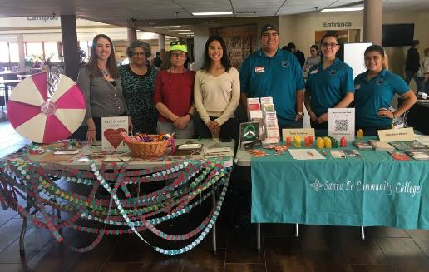
2018 tactics
Petition Collecting
Recruiting more
advocates

Slide 13
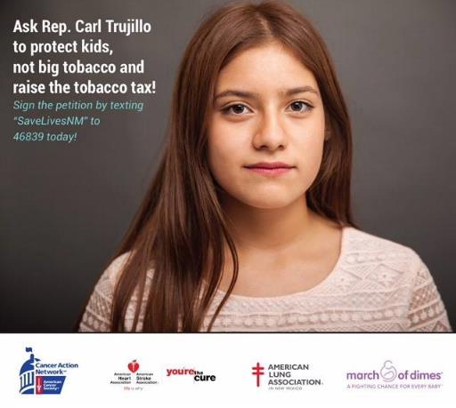
2018 tactics
Paid Media

Slide 14
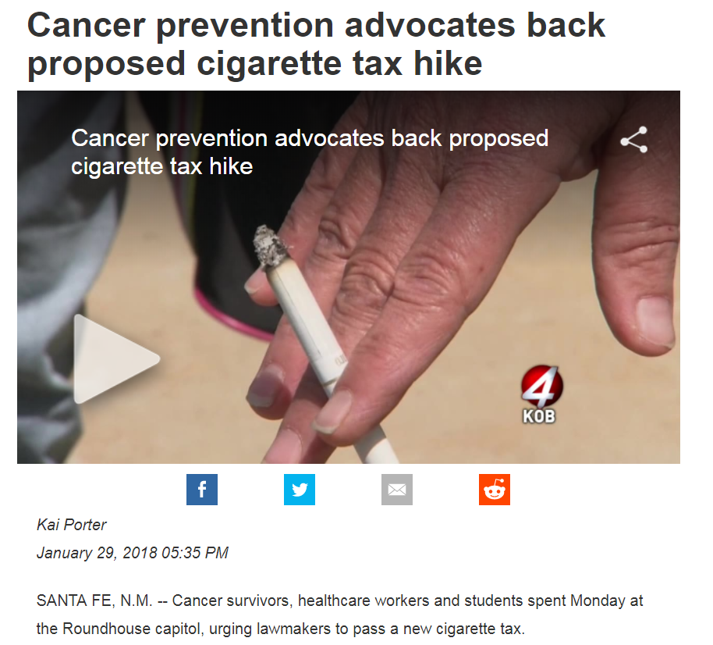
2018 tactics
Earned Media

Slide 15
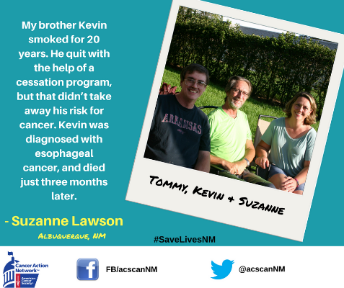
2018 Tactics
Social Media

Slide 16
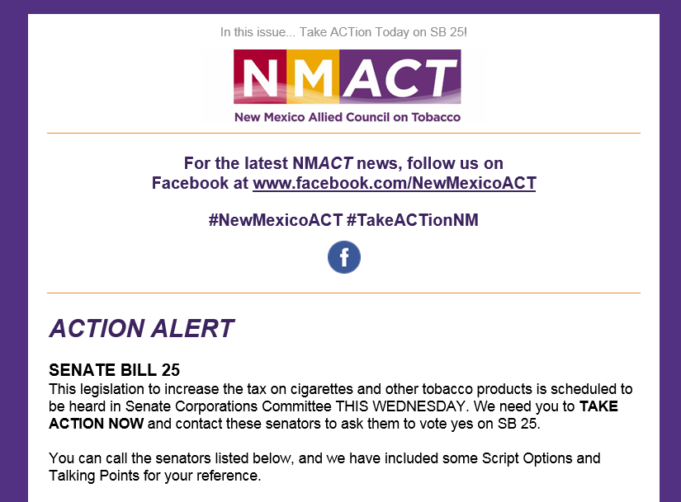
2018 tactics
Action alerts

Slide 17
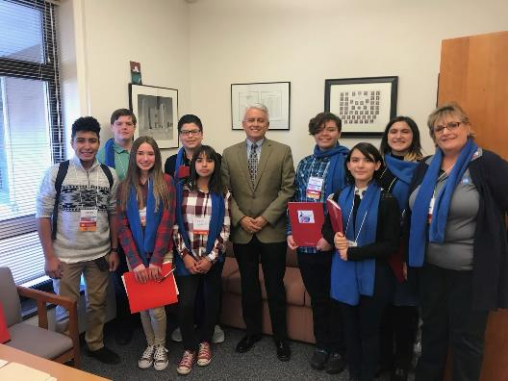
2018 tactics
Lawmaker Meetings:
interim and
during session

Slide 18
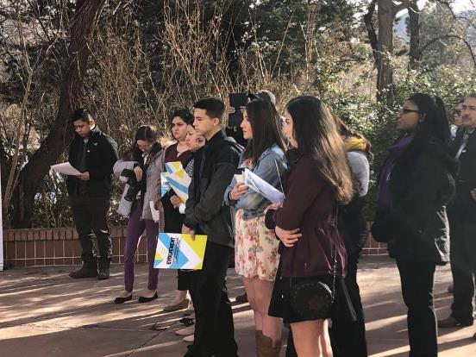
2018 tactics
Days at the
Capitol

Slide 19
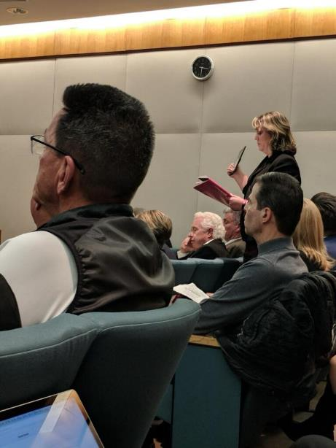
2018 tactics
Public comment
during committee
hearings

Slide 20
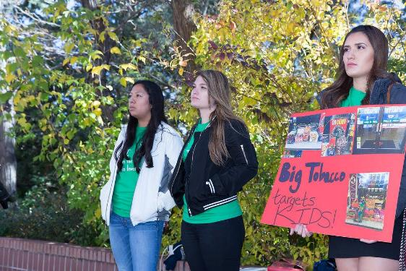
Designing tactics that pop
Always depend on the target.
Must be:
In context
Backed up by power
Flexible and creative

Slide 21
Designing tactics that pop
Tactics should..
Share personal stories
Be creative and outside the experience of the target
Help us hone our skills and develop new leaders
Include messages that are easy to communicate to the public
Some ways to increase power are…
Involve large numbers of people
Involve the media
Share via social media
Conduct your tactic in a public setting
Take pictures and/or video

Slide 22
#Takeactionnm
Hold for a good tactic

Slide 23
How do I get involved?
Join the committee that most suits your interests!
Communications Committee
Capacity Building Committee
Action Committee
Encourage others to participate
Participate in policy action or education
Help us celebrate our wins!

