Slide 1
Campaign for Tobacco-Free Kids
2018 New Mexico ACTion Conference
Albuquerque, New Mexico
Claudia Rodas
Director, Southern Region
May 15, 2018

Slide 2
OUR VISION:
A future free of the death and disease caused by tobacco.
We work to save lives by advocating for public policies that
prevent kids from smoking,
help smokers quit and
protect everyone from secondhand smoke.

Slide 3
A Brief Timeline
CTFK created in 1995/ Formally Opened in June 1996 – Original focus - US
Became involved in international issues in 1999 – Through negotiations of Framework Convention on Tobacco Control and as founder of Framework Convention Alliance
Expanded International activity with grant from Michael Bloomberg and Bloomberg Philanthropies – Fall 2006 and then Gates
Global Health Advocacy Incubator – 2014

Slide 4
3 Factors Led to Creation of CTFK
A recognition that the best approach to reducing tobacco use focuses on population based actions
A recognition that success requires a focus on political and social change and that to succeed in that arena requires a different approach and different skills
Specific events that occurred in the mid 1990s, mid 2000s, and in 2014

Slide 5
US Programs Structure
PRESIDENT AND CEO
Matt Myers
EVP US PROGRAMS
Bill Lee
FEDERAL GOV’T RELATIONS
Anne Ford
STATE ADVOCACY
Chris Sherwin
LEGAL AND REGULATORY
Denny Henigan
COMMUNICATIONS
Vince Willmore
RESEARCH
Meg Riordan & Nichole Veatch
YOUTH ADVOCACY
Gustavo Torrez

Slide 6
Global Structure
EVP Global Programs
Communications
Research
Legal
Operations
President and CEO
China Indonesia Philippines
Bangladesh
India Pakistan
Ukraine Eurasia
Africa
Brazil Mexico Latin America
Trade Litigation Fund
Advocacy Incubator
Incubator Team
Matt Myers
Yolonda Richardson
Vandana Shah
Mark Hurley
Danny McGoldrick
Patricia Sosa
Patricia Lambert
Xi Yin
Rob Eckford
Joshua Abrams
Pam Sumner Coffey
Bintou Camara
Maria Carmona
In Country Team

Slide 7
Our Focus: Evidence Based Population Level Solutions
Approaches that “are likely to have the greatest long term population impact”
are
“economic, regulatory and comprehensive”.
2000 Report of the Surgeon General

Slide 8
Policy Change Does Not Just Happen
Bring the science to bear – make it relevant, clear and visible
Make tobacco issue visible to public
Frame the issue
Mobilize effective support – It is not enough to be right
Engage in Effective Direct Advocacy
Support Concrete Evidence-Based Solutions
Sustain the effort over time – Fundamental change doesn’t happen over night.

Slide 9
Our Charge: Bring An Integrated Approach To Tobacco Control Advocacy
ADVOCACY: Lead efforts to pass public policies that reduce tobacco use
COMMUNICATIONS: Conduct media campaigns to support policy change, keep tobacco issue visible and framed as serious public problem, and expose the tobacco industry
RESEARCH: Serve as the information resource to drive advocacy and communications efforts
COALITIONS & GRASSROOTS: Mobilize organizations and individuals to join the fight
LEGAL ASSISTANCE: Legal support for advocacy efforts; participation in key court cases.

Slide 10
The Campaign’s Dual Role:
What Does that Look Like at the Federal Level:
Strategic leadership
Direct advocacy (lobbying)
Communications
Research
Coalitions and grassroots
Legal work

Slide 11
Examples of Leadership at the Federal Level
In Congress: We led the Campaign to give FDA authority over tobacco; Now we coordinate efforts Defending FDA’s authority and Supporting Funding for CDC
With the FDA: Pushing FDA to issue Deeming Rule; Supporting FDA’s smokeless tobacco product standard
In Court: Suing FDA to compel them to issue Graphic warnings; Defending FDA’s Deeming Rule from tobacco industry legal attack

Slide 12
The Campaign’s Dual Role
What Does it Look Like at the State and Local Level
We support campaigns and organizations with wide range of strategic assistance:
Strategic advice
Research
Paid and Earned Media
Grassroots
Legal

Slide 13
Today
The Tobacco Control Situation
and
Perspective Looks Entirely Different
From When
We Were Created in 1996

Slide 14
US Adult Smoking Trends, Twenty Years Of Progress
37% decline
*
Source: National Health Information Survey, 1997-2016

Slide 15
US Adult Daily Smoking Trends, Twenty Years of Progress
42% decline
Source: National Health Information Survey, 1997-2016

Slide 16
US Adult Smoking Trends, 1997 - 2016
Overall Smoking Prevalence
39% Decline
44% Decline
Source: National Health Information Survey, 1997 - 2016
Notes:
Similar declines have been seen among adult smokers, both in overall smoking prevalence and daily smoking. Since 1965, the year following the first Surgeon General’s report on smoking, and the first year that CDC tracked adult smoking, there has been a 64% decline in adult smoking.
As with youth, we have exceeded CDC’s “winnable battle” goal of reducing adult smoking to 17% by 2015.

Slide 17
20 Year US High School Smoking Trends: Progress that was Unimaginable
70% decline
Source: Youth Risk Behavior Surveillance Survey, 1991 - 2015
Notes:
High school senior smoking rates have fallen from 36.5% in 1997 to 10.5% in 2016. Daily high school senior smoking rates have fallen from 24.6% in 1997 to 4.8% in 2016

Slide 18
This progress was no accident.
We know what works.

Slide 19
From 1997 until 2009 The Major Changes were Driven by Change at the State and Local Level
Tax
Smoke-Free
Program Funding

Slide 20
Federal Cigarette Excise Tax + Average State Cigarette Tax, 1995-2018
federal rate ($1.01) +
current state average ($1.75*):
$2.75 per pack
2001 federal rate (34¢) + state average (43¢):
77¢ per pack
1996 federal rate (24¢) + state average (33¢):
57¢ per pack
* Includes state cigarette tax rates passed as of April 1, 2018. Implementation date of OK $1.00 increase TBD. Does not include local cigarette taxes, 19 of which are $1.00 or higher, including Anchorage, Aspen, Chicago, New York City, and Philadelphia.
April 2018

Slide 21
Percent of Population Covered By Smoke-Free Laws
(Workplaces, Restaurants & Bars)
Through April 1, 2018: 59%*
25 states and hundreds of
communities are smoke-free
11/27/2002: 3%
DE becomes 1st smoke-free state
in all workplaces,
restaurants and bars
1996: < 1%
Comprehensive smoke-free laws
in 7 communities nationwide
Source: American Nonsmokers’ Rights Foundation, laws in effect as of January 1 of each year except most recent year, which is most recent quarterly report; Census population figures updated December 2003, April 2009, and January 2017

Slide 22
Total Annual State Tobacco Prevention Spending, FY1999 - FY2018
Only 3 states – AZ, CA and MA - spent any money on tobacco prevention prior to 1999. Settlement payments to states began in 1999. All states were receiving payments by 2001. Funding amounts only include state funds.
* State spending for FY16 includes $13.7 million for Pennsylvania that was not available for the 2015 Broken Promises Report.

Slide 23
Acceleration of Action at the National Level since 2009
2009 Tobacco Control Act – limited marketing, banned flavored cigarettes, increased youth access enforcement.
2009 – 61.5₵ increase in the federal excise tax
2009 – PACT Act – limited mail order and internet sales
Unprecedented mass media – each of which produced measurable and meaningful results
CDC – multi-year Tips From Former Smokers campaign
FDA – “The Real Cost” youth tobacco prevention campaigns
Truth Initiative – re-invigoration of Truth mass media campaigns
CTFK played a leading role in each of these efforts. Today we play a leading role in advocating to FDA to fully implement the law and defending CDC’s Tobacco Program

Slide 24
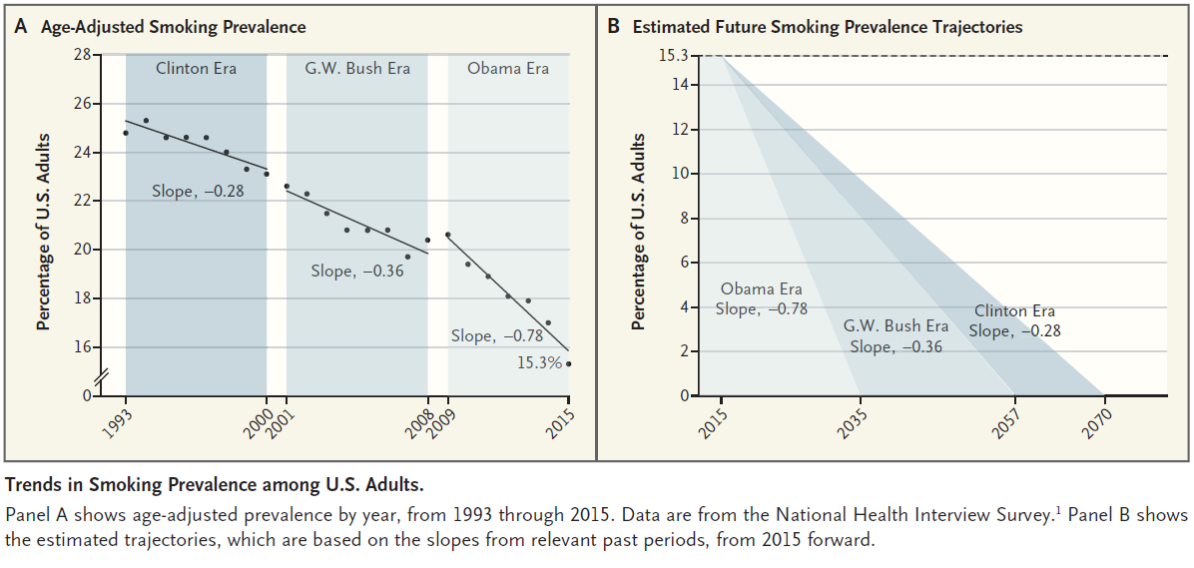

Slide 25
High School Tobacco Use – Proof of What is Possible - In Each the Greatest Decline Was Since 2009
 | Cigarette Use
 | 2000 – 2001 High School Rate | 2015 – 2017 High School Rate | Percent Decline
New York | 27.1% | 4.3% | 84%
Rhode Island | 24.8% | 4.8% | 81%
Florida | 22.6% | 4.2% | 81%
California | 21.6% | 4.3% | 80%
Wisconsin | 32.9% | 8.1% | 75%
Massachusetts | 26% | 7.7% | 70%
Nevada | 25.2% | 7.5% | 70%
Minnesota | 32.4% | 9.6% | 70%
US | 28.0% | 8.0% | 71%
NY, FL, WI, US from Youth Tobacco Survey. MA, NV, RI, US from Youth Risk Behavior Survey (YRBS). CA from CA Student Tobacco Survey.

Slide 26
BUT The Challenges that Remain are Substantial
Three Broad Categories
Who Smokes Has Changed – with Real Consequences
The Emerging Threat of Other Tobacco Products and Poly Tobacco Use
Today We will Need to Make Progress in the Wake of the New Political Realities

Slide 27
The Problem: US Adult Smoking Disparities, 2016
Source: National Health Information Survey, 2016

Slide 28
Who Smokes? The Poor
Source: 2013-2014 Adult Tobacco Survey

Slide 29
Education and Employment Are Critical
SOURCE: SAMHSA, Center for Behavioral Health Statistics and Quality, National Survey on Drug Use and Health, 2016

Slide 30
US Adult Smoking by Health Insurance Type, 2016
2016 National Rate: 15.5%
Source: National Health Information Survey, 2016
Notes:
Updated

Slide 31
Pregnant Medicaid enrollees particularly vulnerable
Maternal smoking at any time during pregnancy by source of payment for the delivery
In 2014, 14% of pregnant women with Medicaid coverage smoke versus only 3.6% with private insurance
18.4% of pregnant Medicaid enrollees who smoke quit during pregnancy compared to 28.4% pregnant smokers with private insurance.
Source: CDC/NCHS National Vital Statistics System

Slide 32
Medicaid Enrollees Are Not Being Provided Tobacco Cessation Services
Smokers with Medicaid coverage do not receive help in quitting even though cessation benefits are covered
In 2013 only 1 in 10 current smokers with Medicaid received cessation medications despite the fact that it has been proven that when Medicaid agencies collaborate with PH agencies, physician groups, healthcare advocacy orgs and others to promote tobacco cessation to Medicaid population, it works
Notes:
Population based cessation programs have also been shown to have a positive impact. Massachusetts pave the way with its aggressive program to assist pregnant women on Medicaid

Slide 33
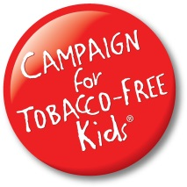
2016 Adult Smoking Prevalence
WASHINGTON
MONTANA
NORTH DAKOTA
MINNESOTA
MAINE
OREGON
VT
IDAHO
WISCONSIN
NH
SOUTH DAKOTA
NEW YORK
MA
WYOMING
MICHIGAN
CT
RHODE ISLAND
NEVADA
NEBRASKA
IOWA
PENNSYLVANIA
NEW JERSEY
UTAH
IN
OHIO
DELAWARE
ILLINOIS
WV
WASHINGTON, DC
COLORADO
KANSAS
MISSOURI
MARYLAND
CALIFORNIA
KENTUCKY
VIRGINIA
TENNESSEE
NORTH CAROLINA
ARIZONA
OKLAHOMA
ARKANSAS
SOUTH CAROLINA
NEW MEXICO
MS
GEORGIA
AL
TEXAS
LOUISIANA
ALASKA
HAWAII
FLORIDA
8.8% - 13.7%
16.2% - 18.5%
14.0% - 15.8%
19.0% - 22.8%
23.6% - 24.8%
Source: Centers for Disease Control and Prevention, 2016 BRFSS online data.
September 2017

Slide 34
Disparities in Policy Progress Translate into Disparities in Use
There are dramatic differences between states.
While the national adult smoking rate has dropped to 15.5% (2016 NHIS) and the youth smoking rate to 8.0% (2016 NYTS)
13 states and DC have adult smoking rates below 15% BUT
12 states have adult smoking rates of 20% or higher
10 states have youth smoking rates under 8%, and
5 states are already under 5% BUT
6 states have youth smoking rates over 15%

Slide 35
State Adult Smoking Prevalence, 2016
Lowest Prevalence
Highest Prevalence
Utah (8.8%)
California (11.0%)
Hawaii (13.1%)
Connecticut (13.4%)
Massachusetts (13.6%)
Maryland (13.7%)
New Jersey (14.0%)
7. Washington (14.0%)
9. New York (14.2%)
10. Texas (14.3%)
West Virginia (24.8%)
Kentucky (24.5%)
Arkansas (23.6%)
Louisiana (22.8%)
Mississippi (22.7%)
Ohio (22.5%)
Tennessee (22.1%)
7. Missouri (22.1%)
9. Alabama (21.5%)
10. Indiana (21.1%)
Average Cigarette Tax: $2.91*
States with Smokefree Restaurants and Bars: 9 out 10
Average Cigarette Tax: $0.88*
States with Smokefree Restaurants and Bars: 1 out of 10
Source: CDC, 2016 BRFSS
*Taxes in effect as of 1/1/18

Slide 36
Smoking Disparities
Contribute to the Growing
Health Disparities in Health
And
Life Expectancy
In the
United States

Slide 37
Growing life expectancy gap between the Rich and the Poor Coincides with Growing Gap in Who Smokes
Researchers at Brookings: there is a growing disparity in life expectancy between high-income and low-income individuals
A study in JAMA also concluded that inequality in life expectancy based on wealth has increased over time.
These changes occur at the same time as the growing disparity in tobacco use between the rich and the poor.
Researchers at Duke and CDC calculated that disparities in smoking rates account for as much as a quarter to a third of the gap in life expectancy by educational level.

Slide 38
If You are Poor: Where You Live Impacts How Long You Will Live
Where you live matters for the poor: Life expectancy among low-income individuals varies by where you live – but there is little or no difference where you live if you are wealthy
If you are poor, your smoking rate also varies based on where you live. The smoking rates of the wealthy are similar wherever they live.
Poor people have lower smoking rates when they live in an environment where the government invests in a safety net
Disparities in life expectancy are not inevitable. There are communities throughout the US, where differences in life expectancy are relatively small.
Source: Chetty, R, et al., “The Association Between Income and Life Expectancy in the United States, 2001-2014,” JAMA, published online April 10, 2016.

Slide 39
If You Are Poor, Where You Live Matters
Low-income people have the shortest life expectancy in localities with low levels of government expenditures
Poor people have better health status when they live in an environment where the government invests in a safety net
Researchers at Duke and CDC calculated that the disparity in smoking rates account for a third of the gap in life expectancy between white men with college degrees and white men with only high school degree
For women, the disparity in smoking rates accounted for a quarter of the gap in life expectancy

Slide 40
Race- and Ethnicity-Adjusted Life Expectancy by Commuting Zone and Income Quartile, 2001-2014
Bottom Income Quartile
Men
Women
Top Income Quartile
Men
Women
Source: Chetty, R, et al., “The Association Between Income and Life Expectancy in the United States, 2001-2014,” JAMA, published online April 10, 2016.

Slide 41
Least Healthy States & Adult Smoking Rates
7 of Least Healthy States are in 10 Highest Smoking Prevalence States
Least Healthy*
Highest Smoking Prevalence‡
Mississippi
Louisiana
Arkansas
Alabama
West Virginia
Tennessee
South Carolina
Oklahoma
Kentucky
Georgia
West Virginia (24.8%)
Kentucky (24.5%)
Arkansas (23.6%)
Louisiana (22.8%)
Mississippi (22.7%)
Ohio (22.5%)
Tennessee (22.1%)
7. Missouri (22.1%)
9. Alabama (21.5%)
10. Indiana (21.1%)
*America’s Health Rankings 2017 Annual Report
‡ Behavioral Risk Factor Surveillance System, 2016

Slide 42
Least Heart Healthy States Have the Highest Adult Smoking Rates
8 of Least Heart Healthy States are in 10 Highest Smoking Prevalence States
Least Heart Healthy*
Highest Smoking Prevalence‡
Mississippi
West Virginia
Kentucky
Louisiana
Alabama
Tennessee
Arkansas
South Carolina
Oklahoma
Indiana
West Virginia (24.8%)
Kentucky (24.5%)
Arkansas (23.6%)
Louisiana (22.8%)
Mississippi (22.7%)
Ohio (22.5%)
Tennessee (22.1%)
7. Missouri (22.1%)
9. Alabama (21.5%)
10. Indiana (21.1%)
*Based on CDC data excess heart age, smoking rates & obesity prevalence data (http://conditions.healthgrove.com/stories/6140/states-healthiest-hearts)
‡ Behavioral Risk Factor Surveillance System, 2016

Slide 43
States with Highest Proportion of Cancer Deaths Attributable to Smoking and Adult Smoking Prevalence
7 States with Greatest Smoking-Attributable Cancer Deaths
are in 10 Highest Smoking Prevalence States
Proportion of Cancer Deaths Attributable to Smoking*
Highest Smoking Prevalence‡
Kentucky (34.0%)
Arkansas (33.5%)
Tennessee (32.9%)
West Virginia (32.6%)
Louisiana (32.6%)
Alaska (31.4%)
Missouri (31.3%)
Alabama (31.3%)
Oklahoma (31.1%)
Nevada (30.9%)
West Virginia (24.8%)
Kentucky (24.5%)
Arkansas (23.6%)
Louisiana (22.8%)
Mississippi (22.7%)
Ohio (22.5%)
Tennessee (22.1%)
7. Missouri (22.1%)
9. Alabama (21.5%)
10. Indiana (21.1%)
* Lortet-Tieulent, J, et al., “State-Level Cancer Mortality Attributable to Cigarette Smoking in the United States,” JAMA Internal Medicine, published online October 24, 2016.
‡Behavioral Risk Factor Surveillance System, 2016

Slide 44
States with Highest Adult Prevalence of Diabetes and Smoking
7 of the states with the highest adult prevalence of diabetes are in
10 highest smoking prevalence states
Highest Smoking Prevalence
Diabetes
West Virginia (15.0%)
Alabama (14.6%)
Mississippi (13.6%)
Arkansas (13.5%)
Kentucky (13.1%)
South Carolina (13.0%)
Tennessee (12.7%)
Georgia (12.1%)
Louisiana (12.1%)
10. Oklahoma (12.0%)
West Virginia (24.8%)
Kentucky (24.5%)
Arkansas (23.6%)
Louisiana (22.8%)
Mississippi (22.7%)
Ohio (22.5%)
Tennessee (22.1%)
7. Missouri (22.1%)
9. Alabama (21.5%)
10. Indiana (21.1%)
Source: Behavioral Risk Factor Surveillance System, 2016

Slide 45
The Continued Presence of Menthol
Despite later initiation and smoking fewer cigarettes/day on average, African American men have 18% higher incidence rates and 20% higher death rates for lung cancer.
The Question is WHY?
There is no certain explanation. Possible reasons:
While adult smoking rates are nearly equal to whites, African Americans quit smoking at lower rates. African Americans use tobacco cessation medications at a lower rate than Whites and are less likely to receive advice to quit from a health professional
The vast majority of African Americans smoke menthol cigarettes which masks the harshness of smoke and is associated with greater addiction and reduced cessation.
Garrett, et al., Nicotine & Tobacco Research, 2016; Alexander, et al., Nicotine & Tobacco Research, 2016; Roberts, et al., Nicotine & Tobacco Research, 2016; Kulak, et al., Nicotine & Tobacco Research, 2016; Holford, et al., Nicotine & Tobacco Research, 2016; American Cancer Society, 2016; Alexander, Nicotine & Tobacco Research, 2016; FDA TPSAC Report on Menthol

Slide 46
The Emergence of
Other Tobacco Products and
Poly Tobacco Use

Slide 49
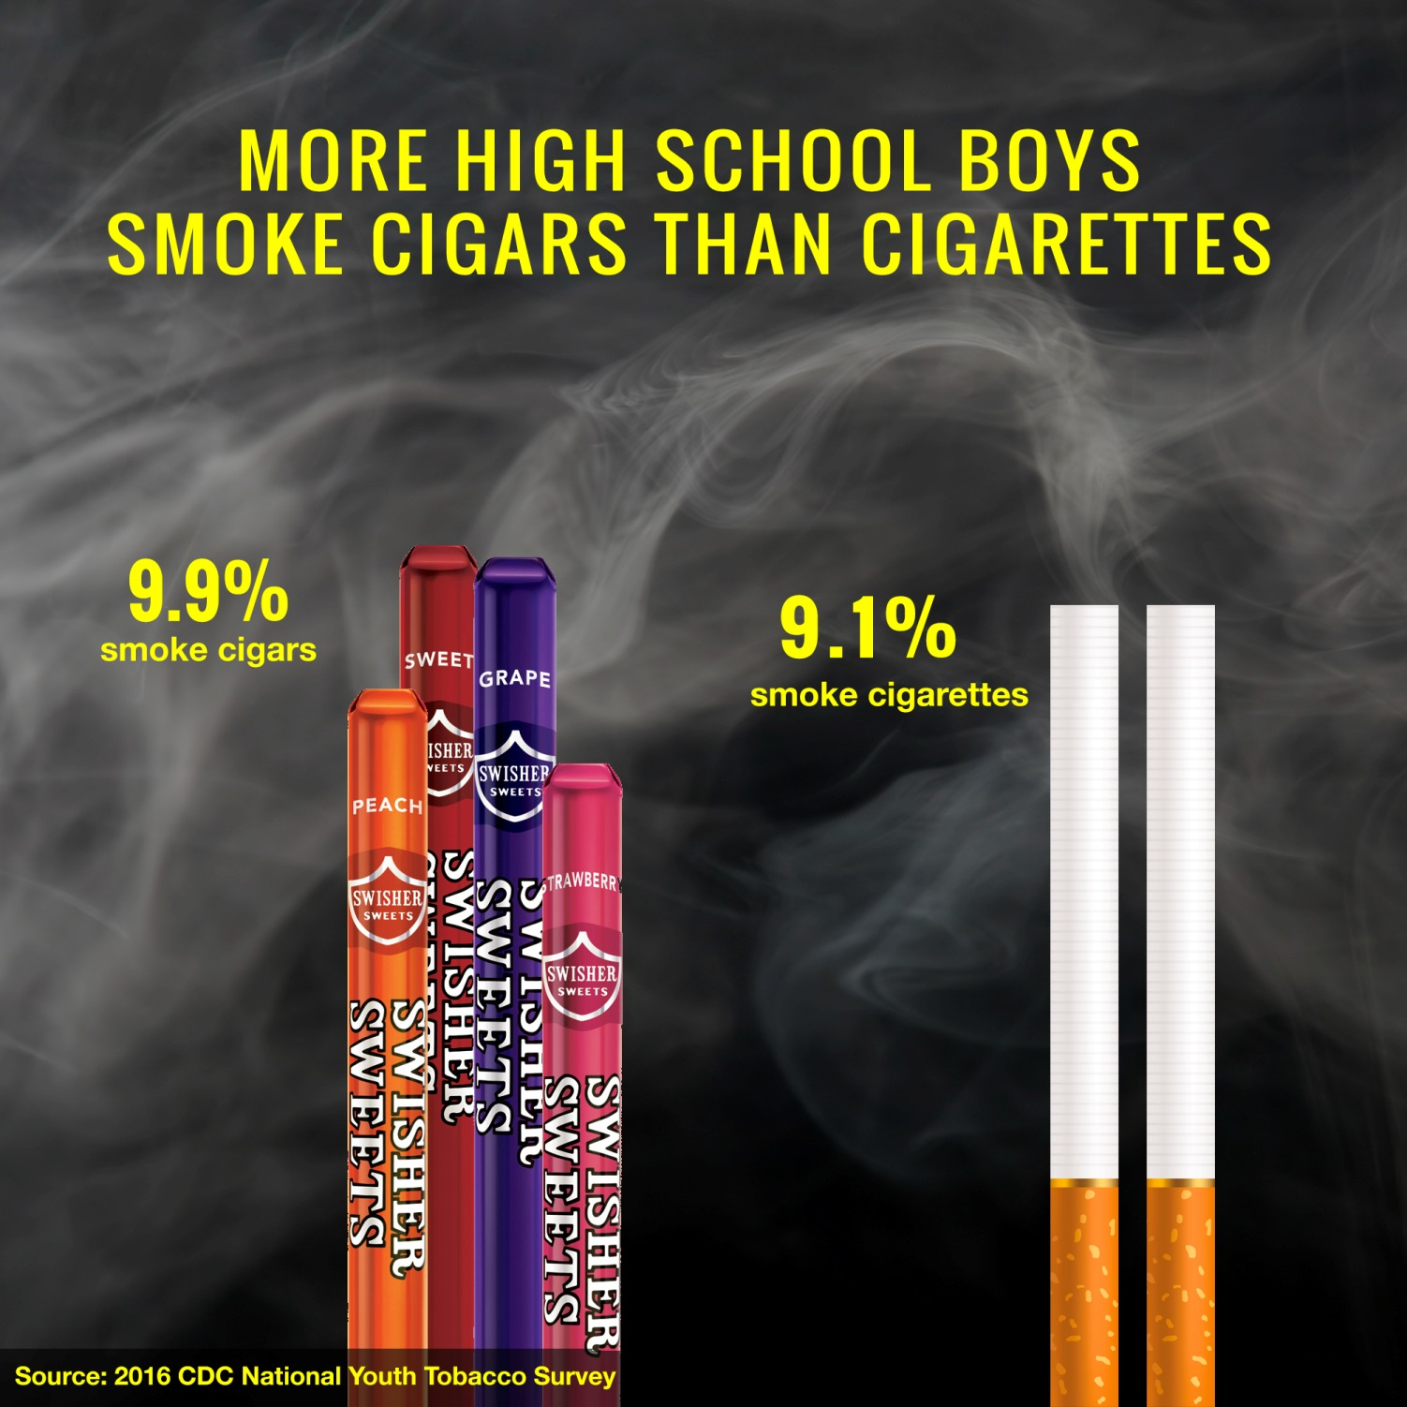

Slide 51
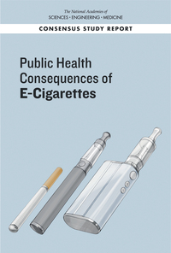
Major Findings from the 2018 NASEM Report on E-Cigarettes
E-cigarettes are not risk-free, but can be far less harmful than combustible tobacco cigarettes if smokers switch completely.
Long-term effects are not yet clear.
Nicotine levels can vary, but can be comparable to levels in combustible cigarettes, resulting in dependence.
E-cigarettes contain and emit numerous potentially toxic substances, although at significantly lower levels than regular cigarettes.
The substances emitted by e-cigarettes can vary depending on the characteristics of the product and how it is operated.
Youth and young adults who use e-cigarettes are more likely to try cigarettes.
There is limited evidence that e-cigarettes may help people stop smoking cigarettes.
There is no available evidence to indicate if using both cigarettes and e-cigarettes (dual use) lowers health risks.

Slide 52
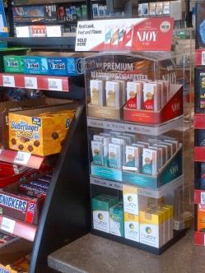
E-Cigarettes Marketing Mimics the Worst of Cigarette Marketing
TV Ads
Kid-Friendly Flavors
Music
Sponsorships
NASCAR Car Sponsorships
Celebrity
Endorsements
Branded Items
Cartoons
“Cigarette Girls”
Countertop Displays

Slide 54
JUUL Popularity Among Youth

Slide 55
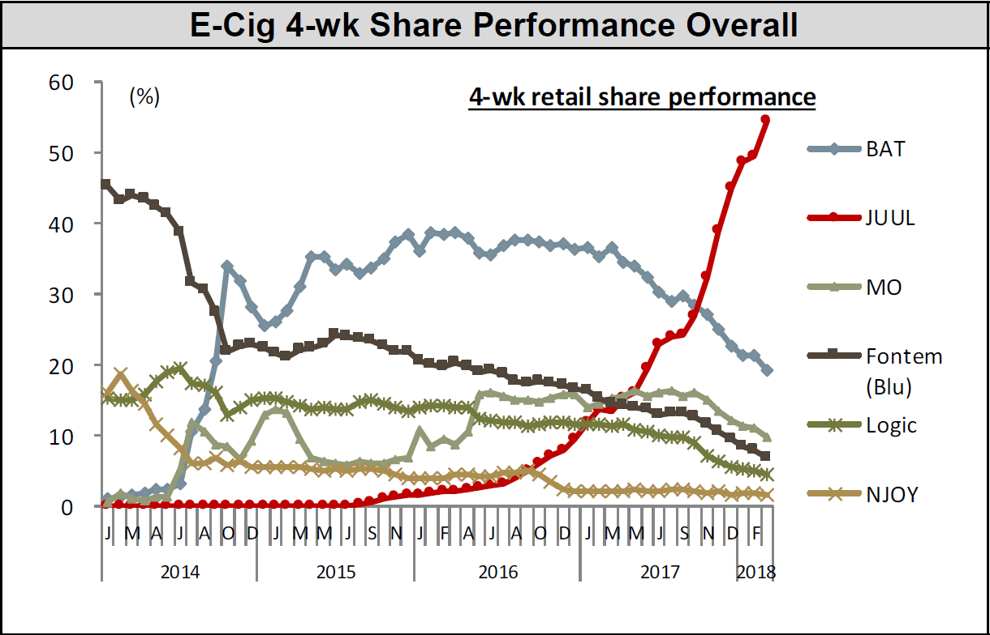
JUUL Market Share: 54.6%
Source: Nielsen Total US xAOC/Convenience Database & Wells Fargo Securities, LLC

Slide 56
The Threats to Tobacco Progress Are Real: The Need to Protect the Engines of Change
Proposals to Weaken FDA authority over tobacco products
Proposed Cuts to Funding for the Office on Smoking and Health at CDC threatens the TIPS media campaign, state quitlines and state tobacco prevention programs
ACA mandates coverage of tobacco cessation treatment for individuals in private plans and many on Medicaid – What will Happen If the ACA is Repealed?

Slide 57
Two Threats are Immediate
Congress curtailment of FDA Authority: Efforts to undercut the legislative authority of the FDA related to Cigars, e-cigarettes and other tobacco products during the Appropriations process
Congressional Budget Attack on CDC-OSH: Proposed Budget cuts to CDC’s Office on Smoking and Health would cut budget by more than half .
Congressional/Industry Attacks to NNN Proposed Standard – Would prevent FDA from moving forward on its first product standard

Slide 58
It is Also a Time to Advocate for Innovative State & Local Policies
Several Examples that Affect Availability, Attractiveness, Affordability
Raising the Tobacco sale age to 21
Restrictions on flavored tobacco products Other than Cigarettes
Innovative Approaches to curtailing Menthol Products
Coupon and discounting bans
Minimum price laws
Tobacco-free retailers

Slide 59
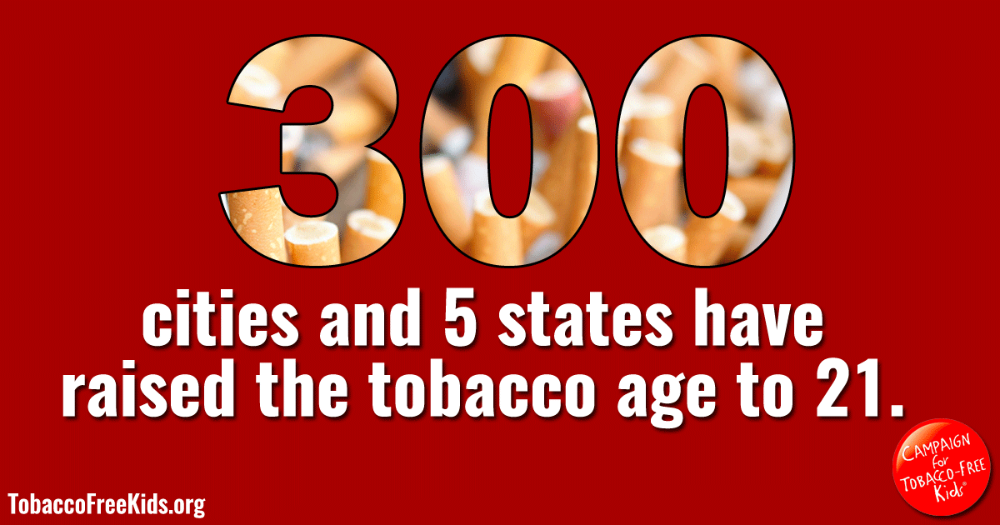

Slide 61
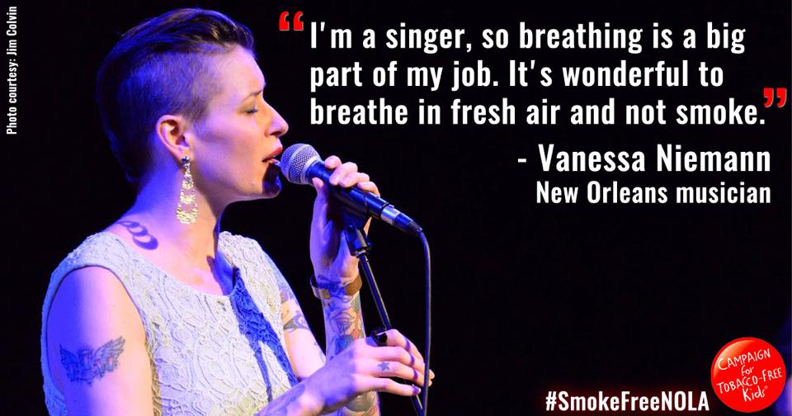
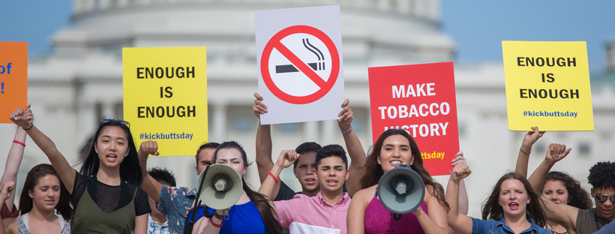
This is why we do what we do….

