Slide 1
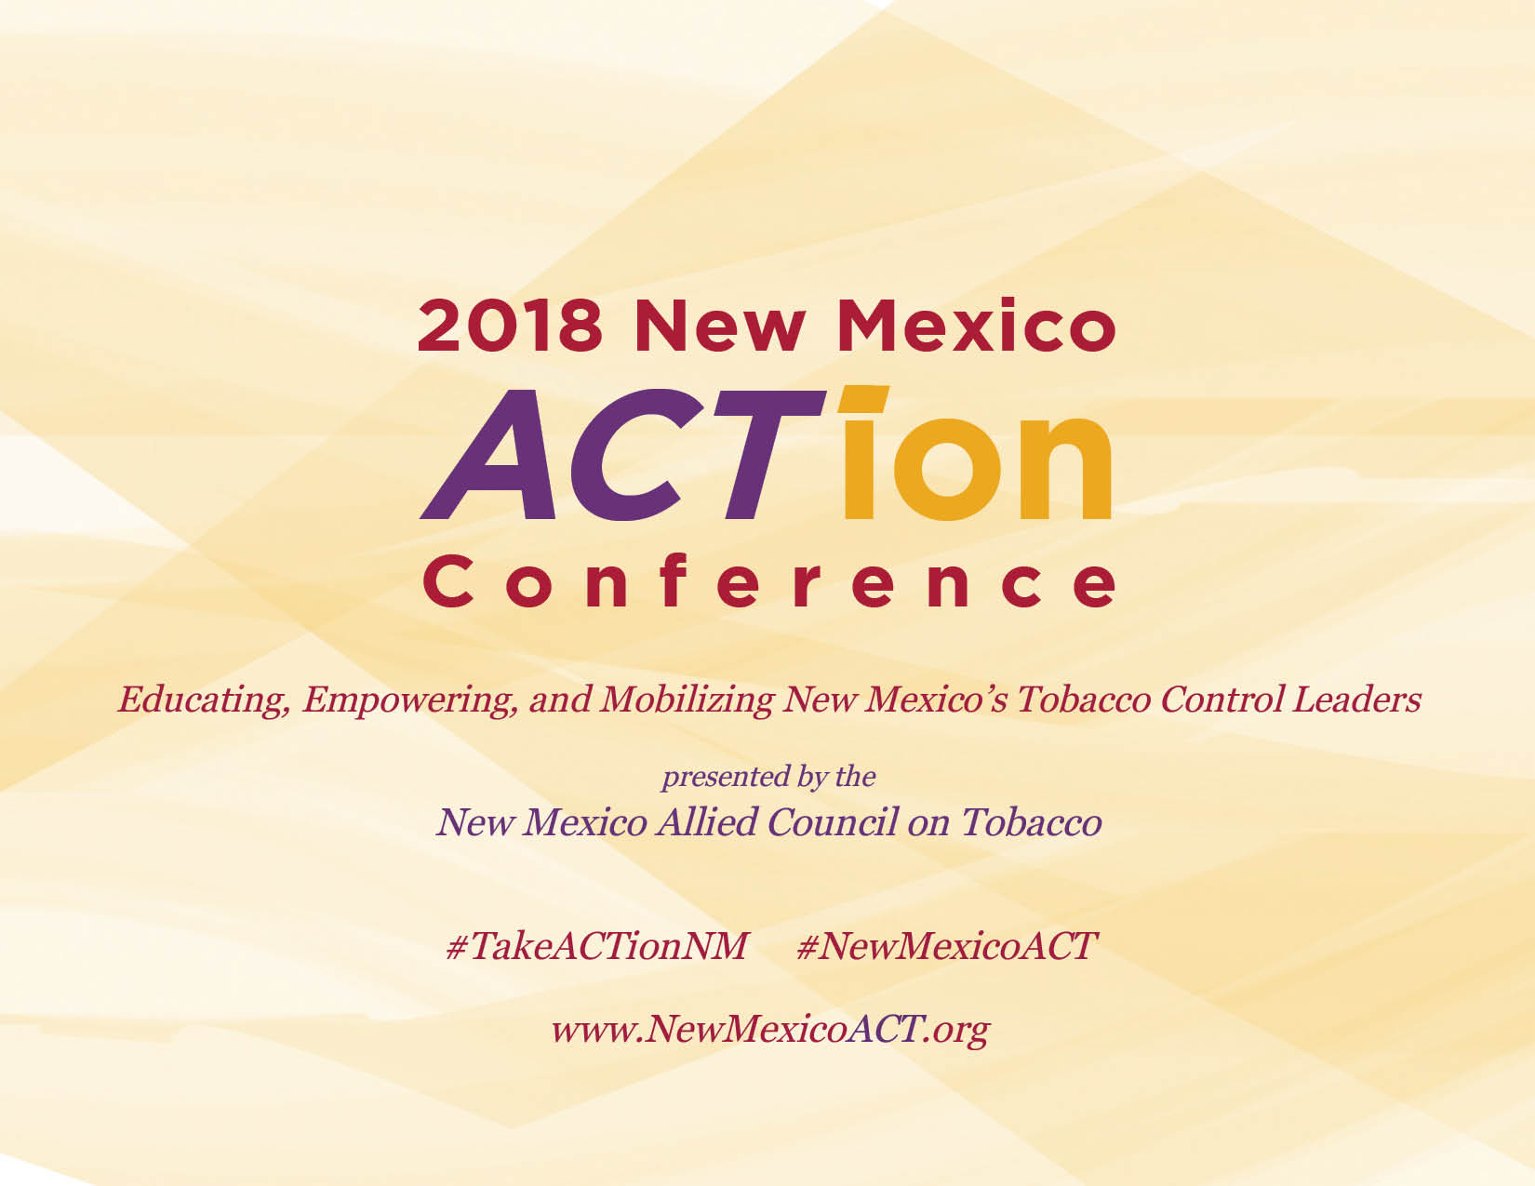

Slide 2
Empowering and Mobilizing Community Members to Make a Difference through Policy Change
Channte’ Keith, National African American
Tobacco Prevention Network
Rachael Lorenzo, Indigenous Women Rising

Slide 3
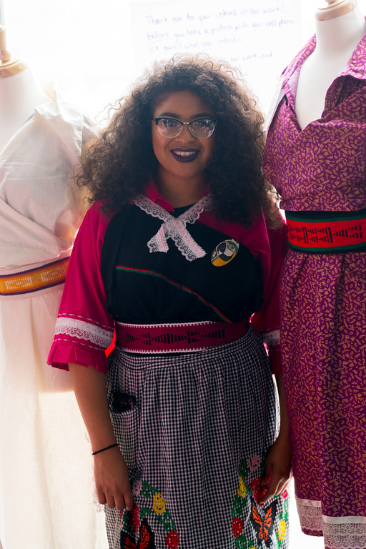
What is community organizing
and why is it important?
Community-led strategies and ownership
Needs assessments
Intersectional lenses
Constant, consistent reflection on our own biases
Who are you leaving out?
Why are you leaving them out?

Slide 4
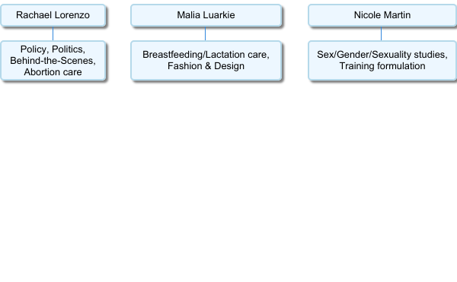
How Indigenous Women Rising works
Minimal hierarchy
Capacity building
“Walking The Walk” & accountability
Self care & support
Common understandings
Creative problem-solving

Slide 5
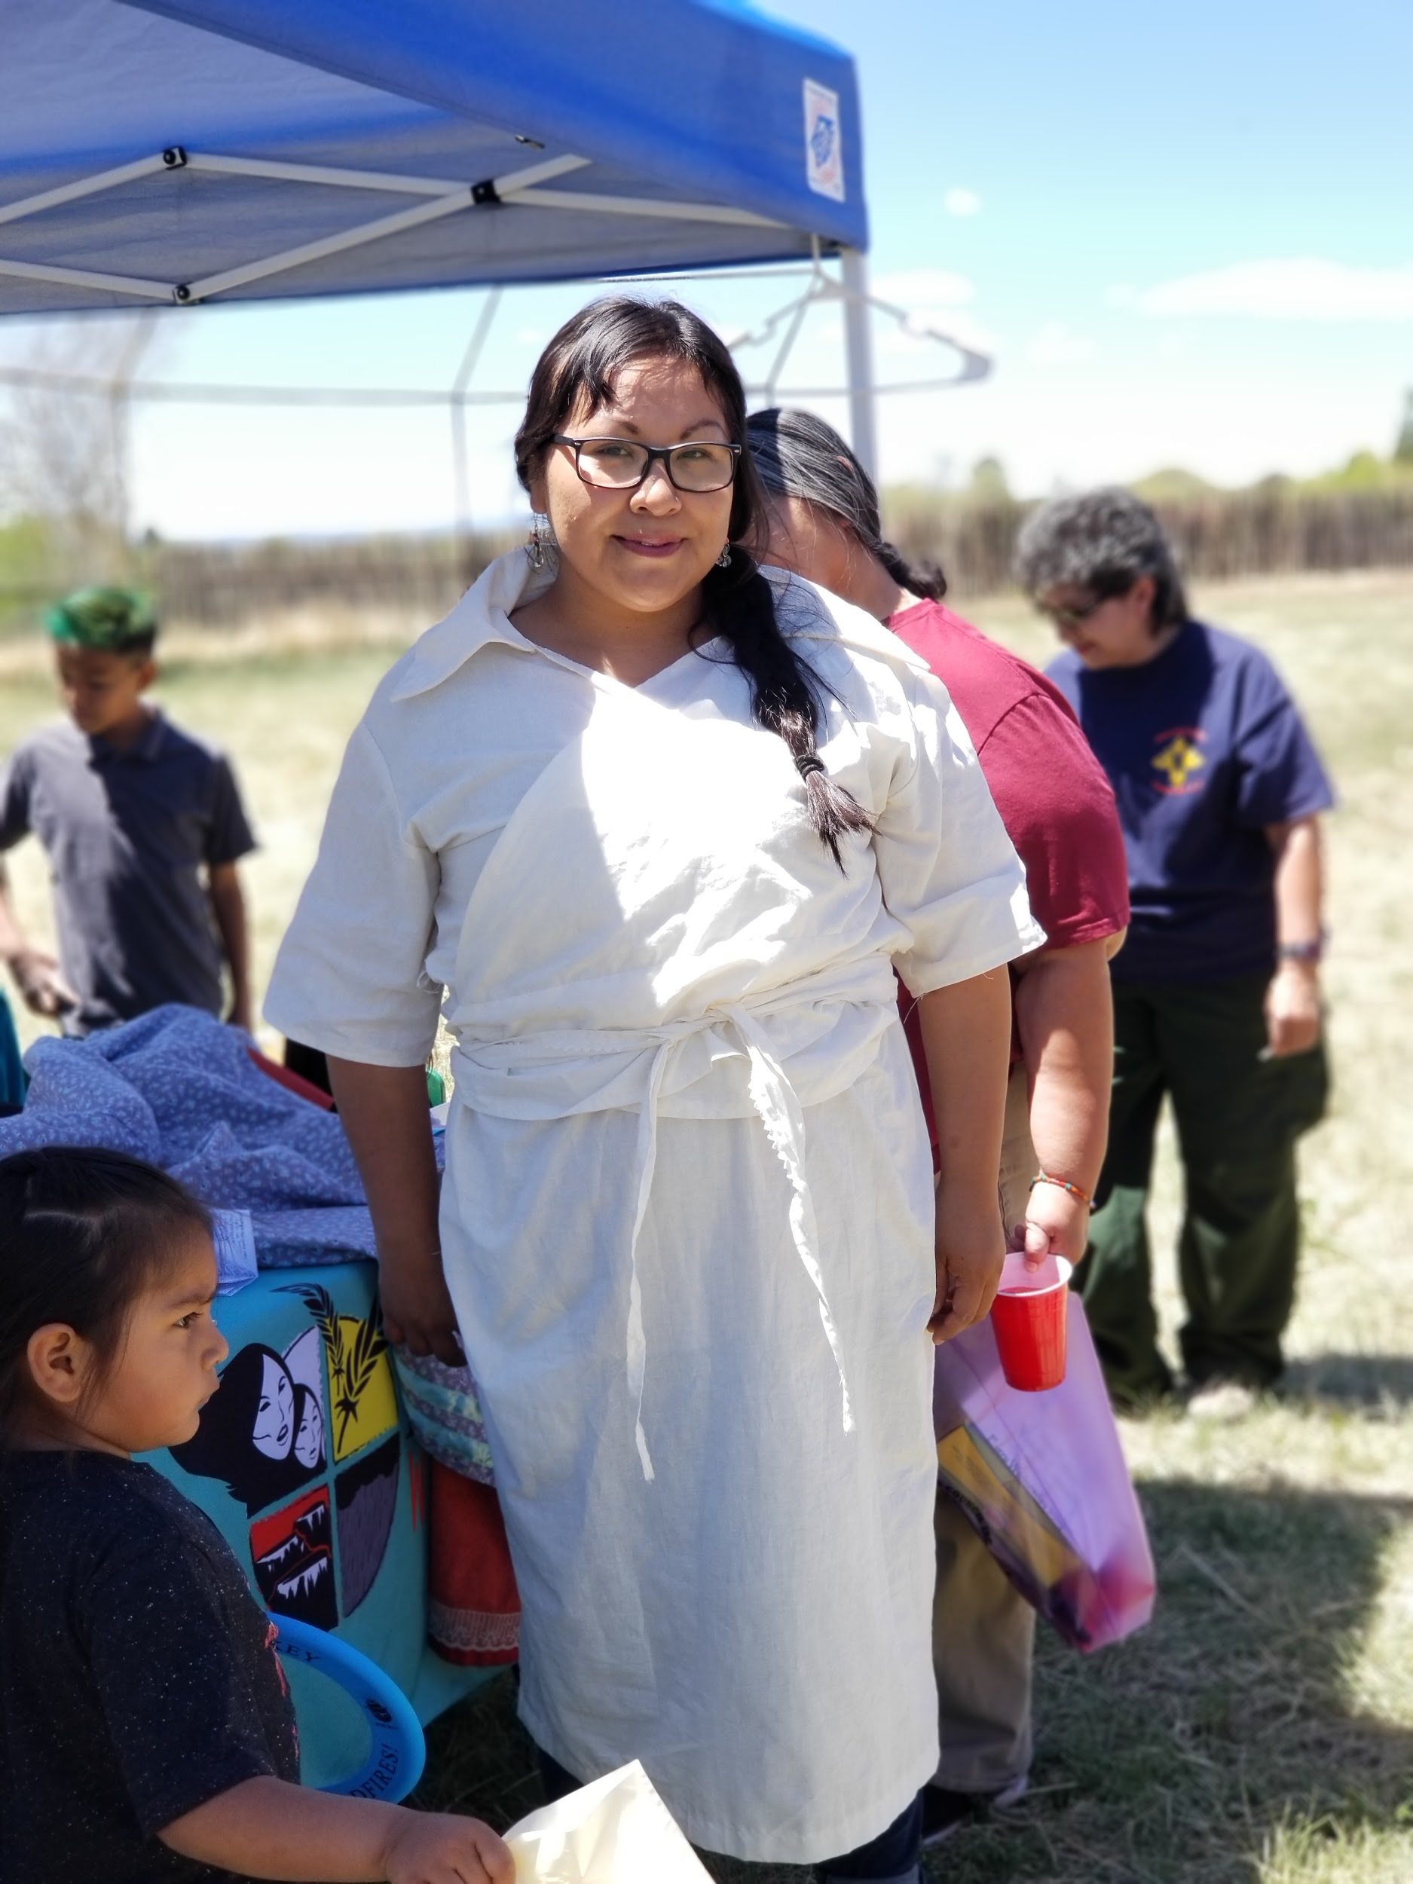
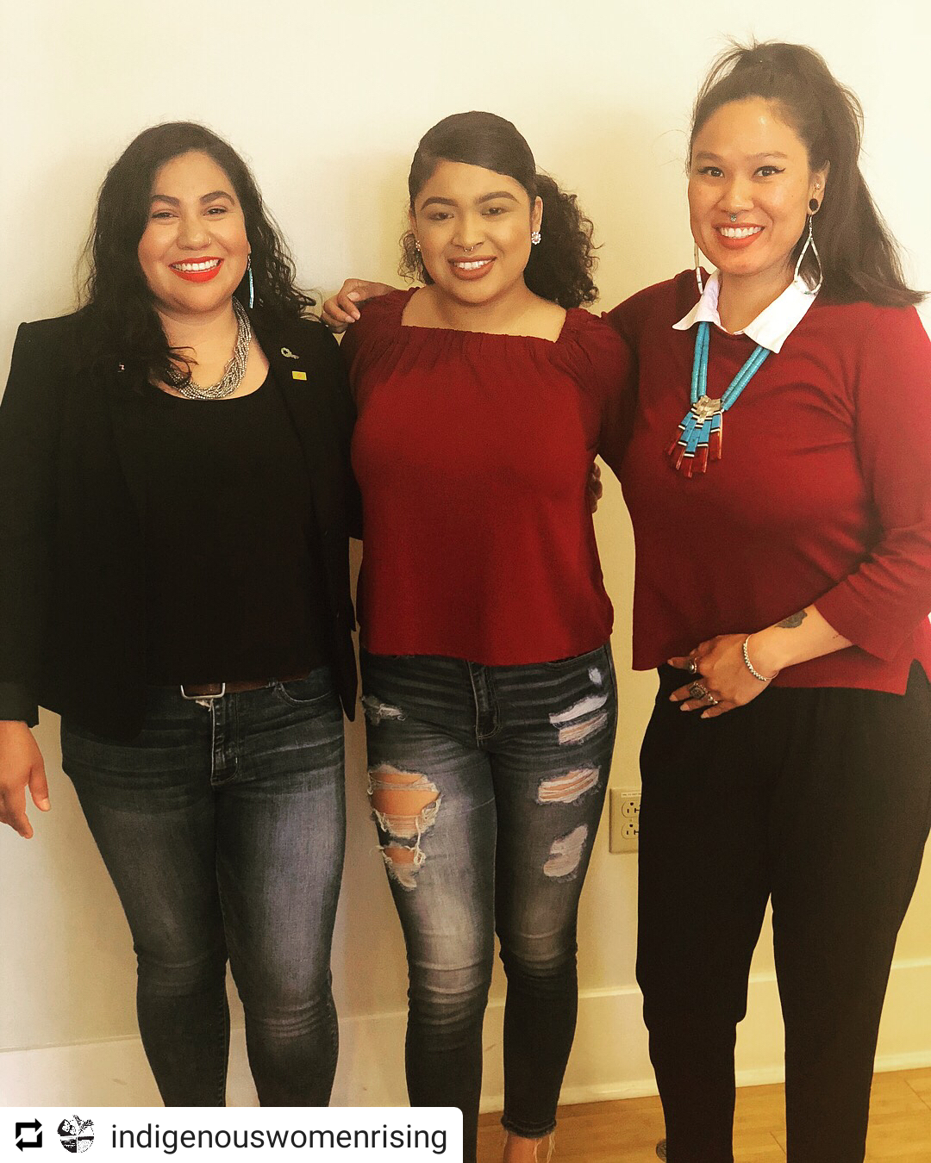
How do we know how our work… works?
More engagement in our tribal communities
Brand recognition
Trusted source of information
More open conversations
Use of terminology
Long-term, reciprocal relationship- organizing vs. mobilizing

Slide 6
NAATPN, Inc. is a national network that facilitates health programs to benefit communities and people of African descent.

Slide 7
WHY TACKLE MENTHOL...
Menthol reduces the harshness of cigarette smoke
Research shows that menthol cigarettes may be more addictive than non-menthol cigarettes
Menthol cigarettes are disproportionately smoked by certain groups, such as adolescents, African Americans, adult females, and families with lower income

Slide 8
WHY TACKLE MENTHOL...
•Overall more than 88 % of African American smokers smoke menthol cigarettes.
•The prevalence use of menthol-flavored cigarettes among African American ages 12-17 is 72%.
•The trend continues into young adulthood, with 85% of African American smokers using a mentholated brand compared to 28.8% of Whites.

Slide 9
WHY TACKLE MENTHOL
•Research shows that smokers who use mentholated tobacco products, have a harder time quitting.
•Young people are more likely to remain with their “starter” type cigarette over time.
•Lack of knowledge among consumers.

Slide 10
WHY TACKLE MENTHOL
•Research shows that smokers who use mentholated tobacco products, have a harder time quitting.
•Young people are more likely to remain with their “starter” type cigarette over time.
•Lack of knowledge among consumers.

Slide 11
WHY FAVOR MENTHOL RESTRICTIONS...
•One in five Americans agree that menthol flavoring in cigarettes should be banned.
•If menthol cigarettes were banned, 38.9% of all menthol smokers, 44.5% of African American menthol smokers, and 64.6% of young adult menthol smokers report they would try to quit smoking.
•If a menthol ban had gone into effect in 2011, researchers estimate conservatively that over 320,000 smoking-attributable deaths would be averted by 2050, almost a third of them among African Americans. g African Americans.

Slide 12
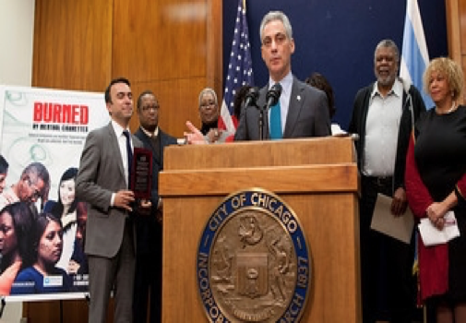
CHICAGO...A LEADER IN
THE MENTHOL FIGHT
Notes:
The City of Chicago recently passed an ordinance to restrict access to all flavored tobacco products (including menthol-flavored cigarettes) near schools. This historic legislation reinvigorated the national dialogue on the regulation of menthol and is inspiring other cities to do more to protect the health of inner city children. No other jurisdiction at any level of government - federal, state, or local - has ever included menthol in the laws that regulate flavored tobacco products.

Slide 13
THE BUFFER ZONE
Creates a 500 ft. Buffer Zone around Chicago Schools
Prohibits the sales of ALL flavored tobacco products
Includes menthol
Includes Black & Milds, Swisher Sweets,
Blunt wrappers

Slide 14
THE BUFFER ZONE
•Tells “our” children they are worth public policy that protects them!
•Is RELEVANT to inner city African American and Latino communities
•Elevates the issue of tobacco control

Slide 15
How Chicago Pulled It Off
(And How Other Communities Can Too!)
Community Input
•Relationship Building
•Legislative Champions
•Media Campaign
•Strong Partnerships

Slide 16
COMMUNITY INPUT

Slide 17
RELATIONSHIP BUILDING
•Getting Community Groups to Join the Movement
Faith Based Institutions
Colleges/Universities
Fraternities and Sororities

Slide 18
THESE ISSUES STAND IN
FRONT OF TOBACCO
•Economic Development
•Racism-Oppression
•Other Health Concerns (Chronic Diseases)
•Poverty
•Violence

Slide 19
HOW TO COMBAT...
With the truth…
Tobacco related deaths of African Americans each year 47,300 vs. Homicides each year 8,650.
Tobacco use is a social justice issue.

Slide 20
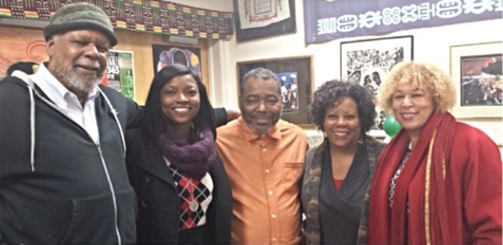
CHICAGO STATE UNIVERSITY

Slide 21
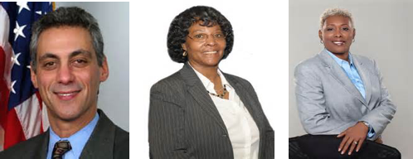
LEGISLATIVE CHAMPIONS
•Mayor Rahm Emanual
•37th Ward Alderman Emma Watts
•16th Ward Alderman JoAnn Thompson

Slide 22
MEDIA CAMPAIGN
•The Chicago Department of Public Health contracted LimeGreen to launch a public awareness campaign to address the chronic use of menthol-flavored tobacco products among youth and minorities.
•This campaign was part of Mayor Rahm Emanuel’s call to action under the City of Chicago’s Public Health agenda entitled ‘Healthy Chicago.’
•LimeGreen was charged with developing the awareness campaign that included television, radio and print creative output.

Slide 23
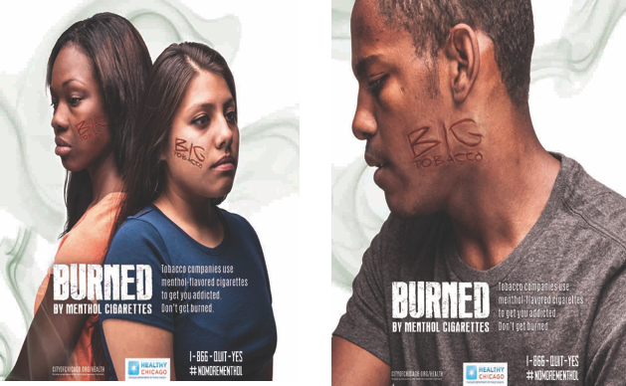
BURNED BY MENTHOL
CIGARETTES CAMPAIGN

Slide 24
STRONG PARTNERS IN THE FIGHT
•Provided technical assistance to city officials and staffers
•Provided expert testimony to city council members
•Gained community support on behalf of the city

Slide 25
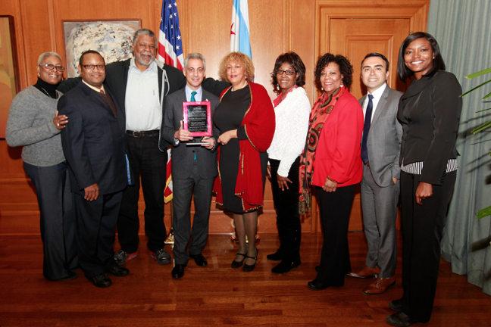

Slide 26
ENGAGING YOUNG PEOPLE
•Passion
•Powerful voice
•Energy
•Creativity
•Different Perspective

Slide 27
HOW TO ENGAGE YOUTH
•Have youth take photos of billboards or storefronts with menthol cigarette advertising.
•Have youth document point of sale advertising of tobacco products.
•Have older youth conduct peer mentoring to younger youth about the harmful effects of tobacco.
Train youth to advocate before county officials on 500 ft bans on mentholated tobacco products. ts.

Slide 28
OTHER COMMUNITIES
San Francisco, CA
Oakland, CA
Minneapolis, MN
Duluth, MN
Philadelphia, PA
ALBUQUERQUE

