Slide 1
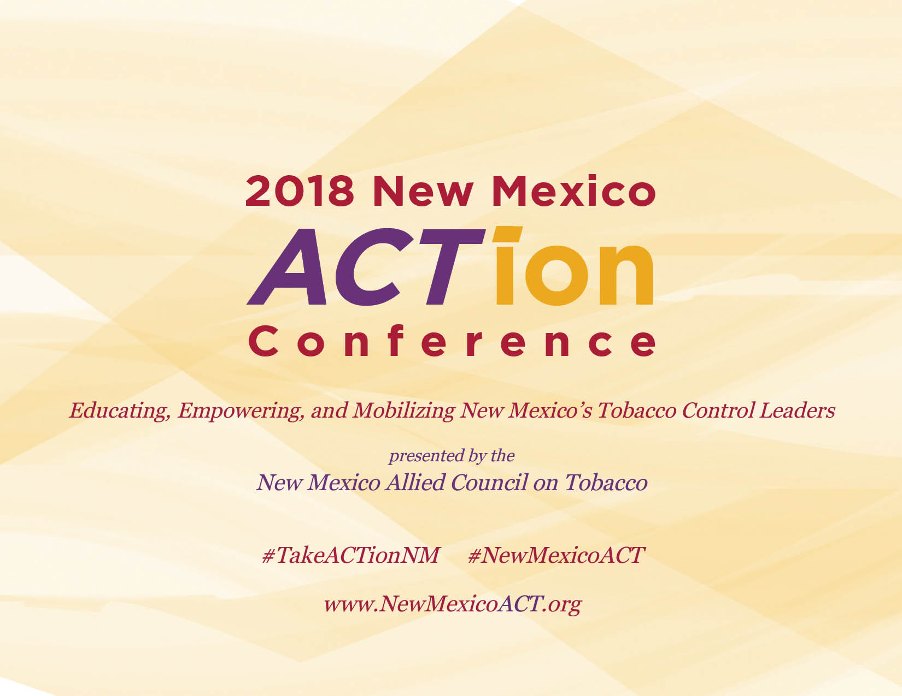

Slide 2
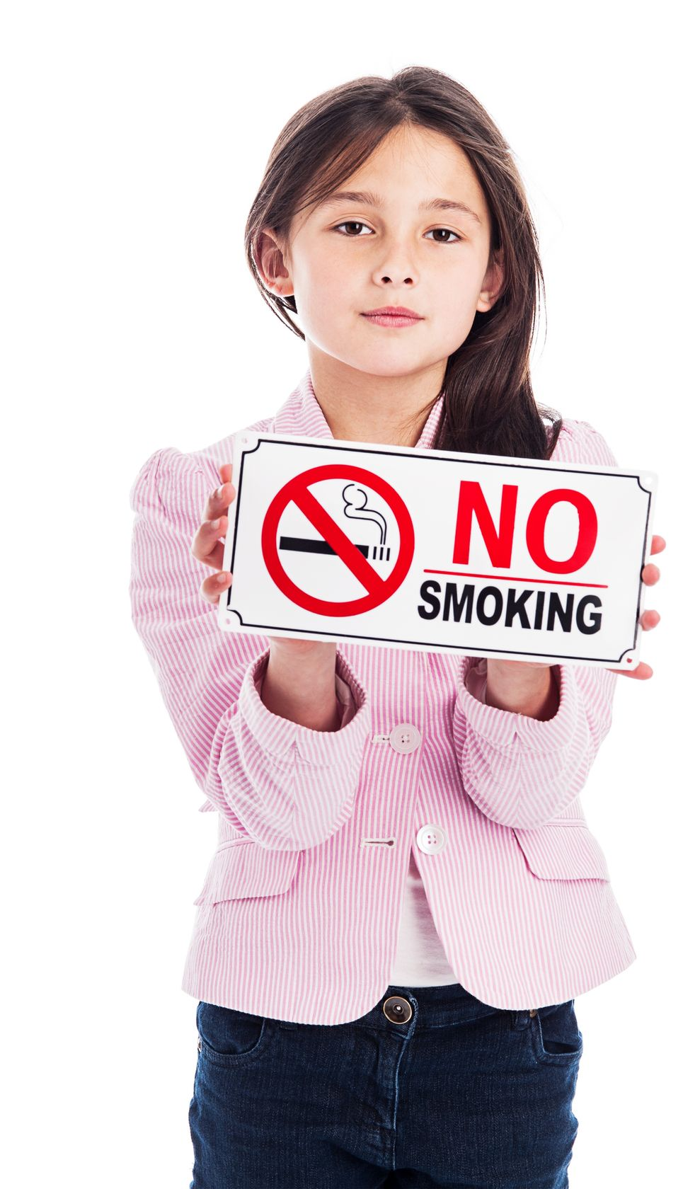
Public Health Promise or Peril?
The Rise of Electronic Tobacco
Products and Implications for
Tobacco Control Policy and Practice
Brian A. King, PhD, MPH
Deputy Director for Research Translation
Office on Smoking and Health
New Mexico Allied Council on Tobacco’s 3rdAnnual ACTion Conference ● May 15, 2018

Slide 3
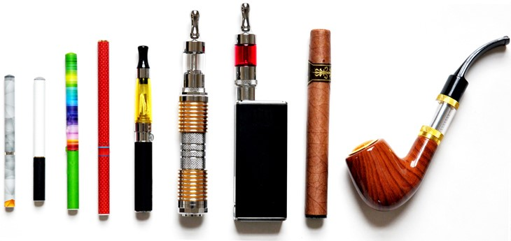
1
Patterns of Use
2
JUUL
3
Heated Tobacco Products
4
Policy Options

Slide 4
1
Patterns of Use
2
JUUL
3
Heated Tobacco Products
4
Policy Options

Slide 5
The Ever Changing Tobacco Product Landscape
Source: Tobacco Situation and Outlook Report, U.S. Department of Agriculture, U.S. Census
Note: Among persons >18 years old. Beginning in 1982, fine-cut chewing tobacco was reclassified as snuff.

Slide 6
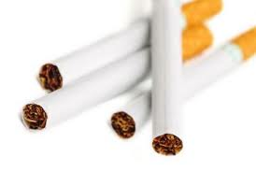
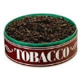
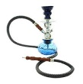
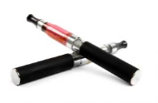
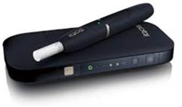
The Evolving
Tobacco Product Landscape
Cigarettes
Cigars, Cigarillos Little Cigars
Smokeless
Pipes
Tobacco
Snus
Hookah
Bidis
Dissolvables
Kreteks
ENDS
Heated Tobacco Products

Slide 7
E-cigarettes

Slide 8
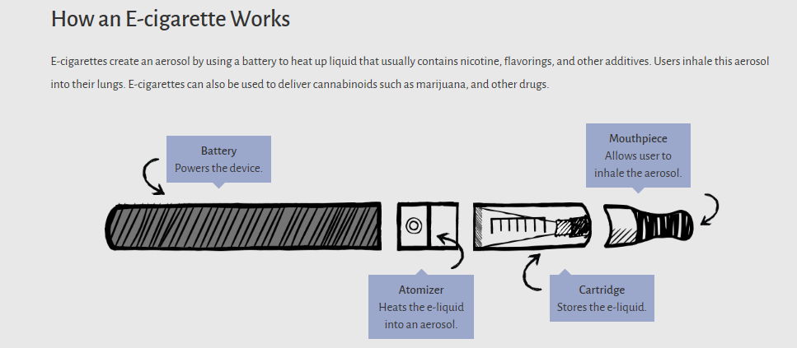
Anatomy of an E-cigarette

Slide 9
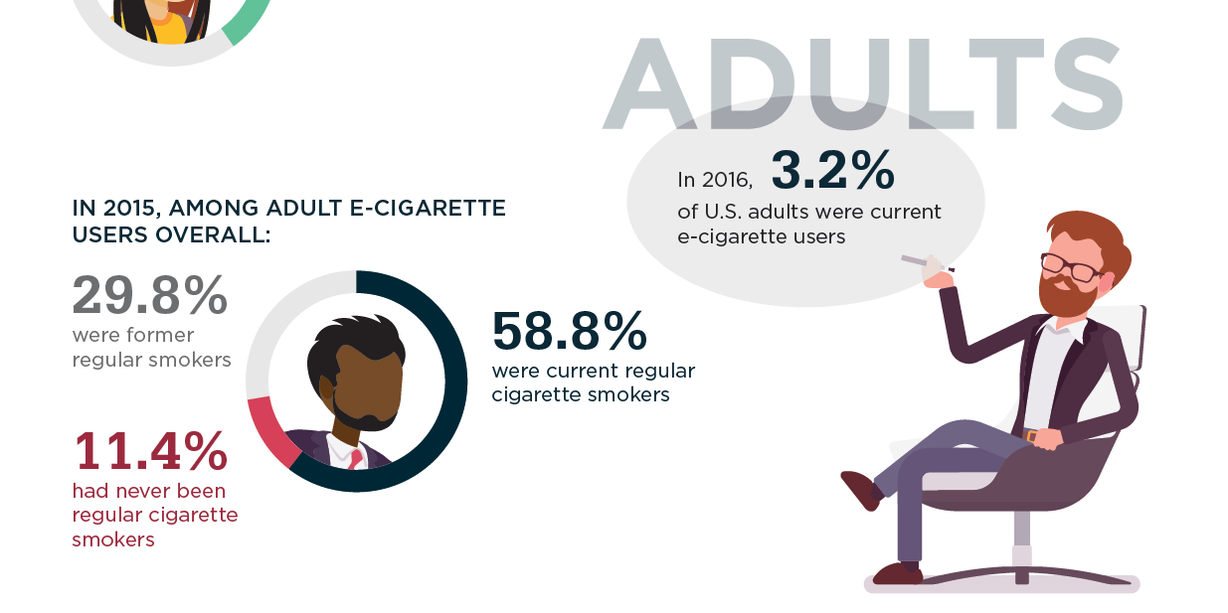
Adult E-cigarette Use

Slide 10
Percentage of U.S Adults Aged ≥18 Who Reported
E-cigarette Use “Every Day” or “Some Days”, 2015
Relative standard error ≥30%
Source: Phillips E, Wang TW, Husten CG, et al. Tobacco Product Use Among Adults — United States, 2015. MMWR Morb Mortal Wkly Rep 2017;66:1209–1215. DOI: http://dx.doi.org/10.15585/mmwr.mm6644a2

Slide 11
Ever Use of E-cigarettes Among Adults,
by Cigarette Smoking Status—U.S., 2010-2017
Source: CDC. Styles Survey. 2010-2016

Slide 12
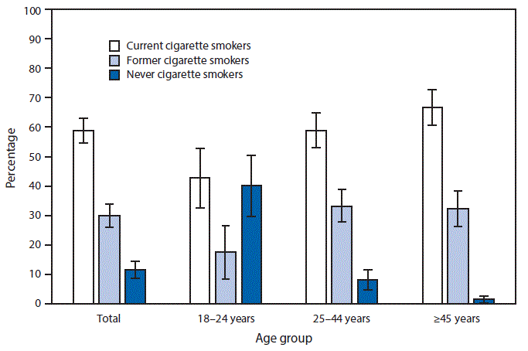
A majority of adult e-cigarette users also smoke conventional cigarettes: “dual use.”
Cigarette smoking status among current
adult e-cigarette users, by age group
Source: QuickStats: Cigarette Smoking Status Among Current Adult E-cigarette Users, by Age Group — National Health Interview Survey, United States, 2015. MMWR Morb Mortal Wkly Rep 2016;65:1177. DOI: http://dx.doi.org/10.15585/mmwr.mm6542a7

Slide 13
E-cigarette Use Frequency Among Current Adult Users
Source: Am J Prev Med. 2018 Feb;54(2):284-288. doi: 10.1016/j.amepre.2017.09.015. Epub 2017 Nov 9.Patterns of E-cigarette Use Frequency-National Adult
Tobacco Survey, 2012-2014.Sharapova SR¹, Singh T², Agaku IT³, Kennedy SM⁴, King BA³.

Slide 14
Primary Reasons for Using E-cigarettes
Among Current Adult Users
Source:Patel D, Davis KC, Cox S, Bradfield B, King BA, Shafer P, Caraballo R, Bunnell R.
Prev Med. 2016 Dec;93:14-20. Reasons for current E-cigarette use among U.S. adults. doi: 10.1016/j.ypmed.2016.09.011. Epub 2016 Sep 7.

Slide 15
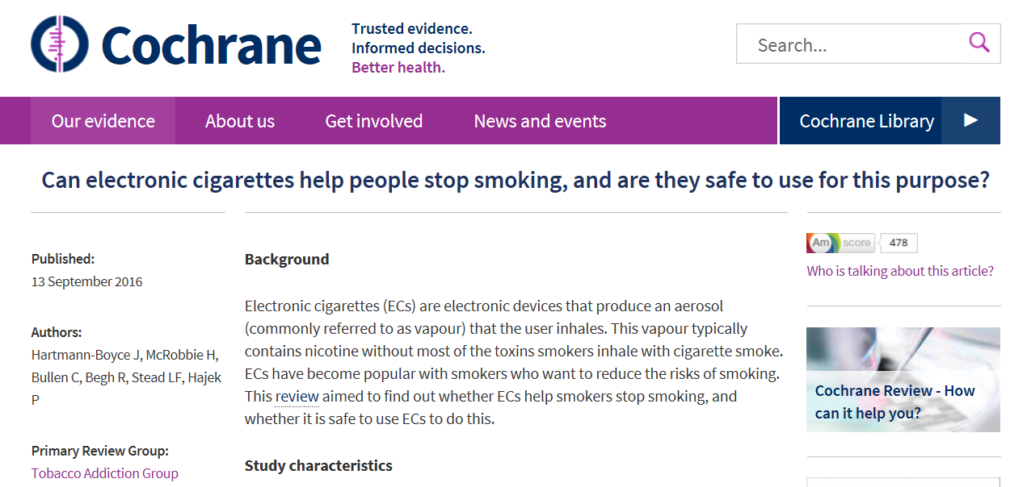
E-Cigarette Use As A
Smoking Cessation
Tool Among Adults
“The long-term safety of e-cigarettes is unknown.”
“Overall, the USPSTF found the evidence on the use of ENDS as a smoking cessation tool in adults, including pregnant women, and adolescents to be insufficient.”
“There is evidence from two trials that e-cigarettes help smokers to stop smoking in the long term compared with placebo e-cigarettes.
However, the small number of trials, low event rates and wide confidence intervals around the estimates mean that our confidence in the result is rated 'low' by GRADE standards.”
Source: https://www.uspreventiveservicestaskforce.org/Page/Document/RecommendationStatementFinal/tobacco-use-in-adults-and-pregnant-women-counseling-and-interventions1

Slide 16
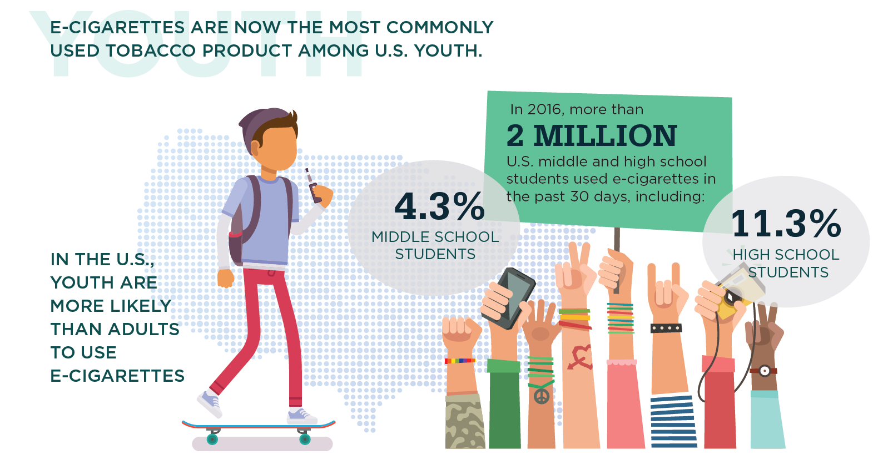
E-cigarette Use Among US Youth

Slide 17
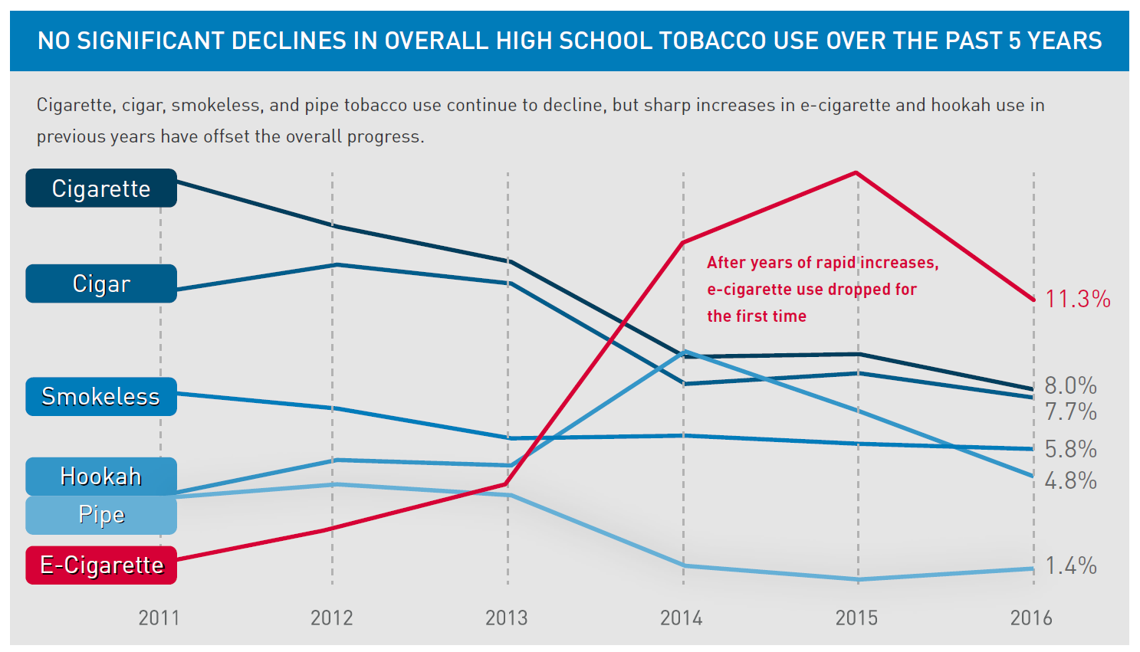
TOBACCO PRODUCT USE AMONG YOUTH

Slide 18
Frequency of Youth E-cigarette Use
Source: Neff LJ, Arrazola RA, Caraballo RS, Corey CG, Cox S, King BA, Choiniere CJ, Husten CG.MMWR Morb Mortal Wkly Rep. 2015 Oct 2;64(38):1061-5.
Frequency of Tobacco Use Among Middle and High School Students– U.S., 2014. doi: 10.15585/mmwr.mm6438a1.

Slide 19
Reasons for Youth E-cigarette Use
Source:Tsai J, Walton K, Coleman BN, Sharapova SR, Johnson SE, Kennedy SM, Caraballo RS. MMWR Morb Mortal Wkly Rep. 2018 Feb 16;67(6):196-200.
Reasons for Electronic Cigarette Use Among Middle and High School Students, NYTS, U.S. 2016.doi: 10.15585/mmwr.mm6706a5

Slide 20
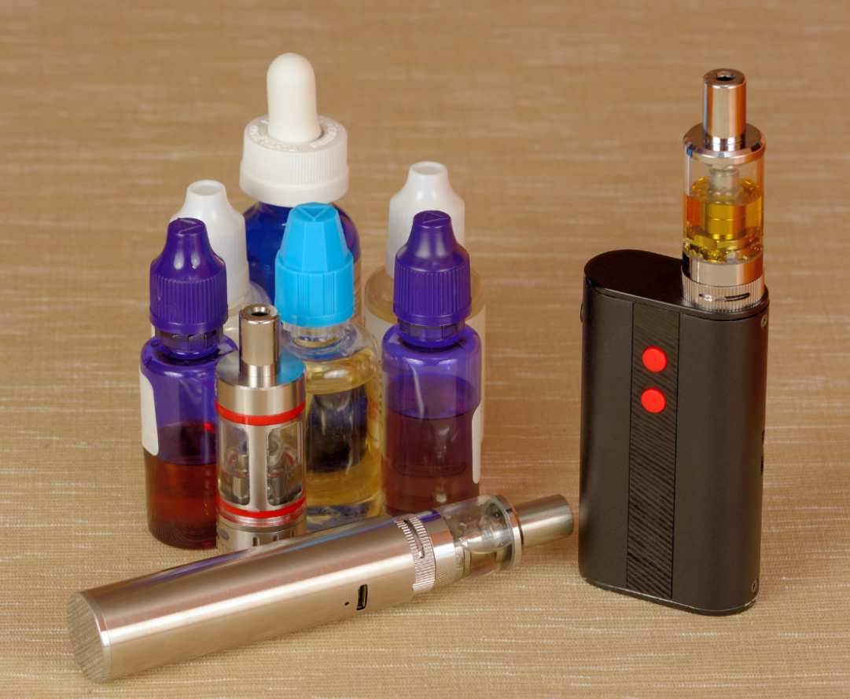
What’s the Deal with Flavors?

Slide 21
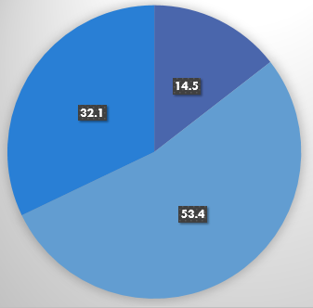
Youth E-cigarette Use, by Type and Brand
Use by Type
Source: Singh T, Kennedy S, Marynak K, Persoskie A, Melstrom P, King BA. MMWR Morb Mortal Wkly Rep. 2016 Dec 30;65(5051):1425-1429.
Characteristics of Electronic Cigarette Use Among Middle and High School Students- U.S., 2015. doi: 10.15585/mmwr.mm655051a2.

Slide 22
Nicotine Poses Unique
Dangers to Young People
Chapter 3
Conclusion 1, 2, & 5

Slide 23
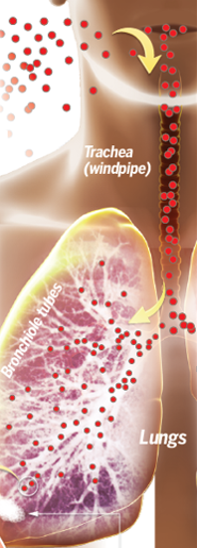
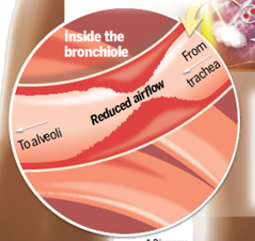
Flavorings
75% of e-cigarette flavors tested contain diacetyl
Diacetyl is associated with bronchiolitis obliterans, a respiratory diseases known as “popcorn lung.”

Slide 24
E-cigarettes and Cannabinoids
Conclusion: E-cigarette products can be used as a delivery system for cannabinoids and potentially for other illicit drugs.”
Sources: Singh T, Kennedy S, Marynak K, Persoskie A, Melstrom P, King BA. Characteristics of Electronic Cigarette Use Among Middle and High School Students — United States, 2015. MMWR Morb Mortal Wkly Rep 2016;65:1425–1429. DOI: http://dx.doi.org/10.15585/mmwr.mm655051a2

Slide 25
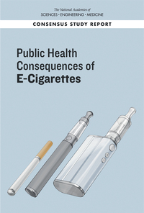
Are E-cigarettes a “Gateway” to Smoking
Conclusion 16-2. Among youth and young adult e-cigarette users who ever use combustible tobacco cigarettes, there is moderate evidence that e-cigarette use increases the frequency and intensity of subsequent combustible tobacco cigarette smoking.
JAMA study
Never smoking high school students who reported ever using e-cigarettes at baseline:
Were 2.7 times more likely to report initiation of combustible tobacco use after 1 year compared with never users of e-cigarettes
JAMA Pediatrics study
Never smoking U.S. adolescent and young adult e-cigarette users at baseline:
Were 8.3 times more likely to progress to cigarette smoking after 1 year than non-users of e-cigarettes
Source: The National Academies of Science, Engineering, and Medicine. Public Health Consequences of E-cigarettes. 2018. Leventhal, Adam, Strong, David, et al, Association of Electronic Cigarette Use with Initiation of Combustible Tobacco Product Smoking in Early Adolescence, JAMA, 2015.
Primack, Brian, Soneji, Samir, et al, Progression to Traditional Cigarette Smoking After Electronic Cigarette Use Among US Adolescents and Young Adults, JAMA, 2015

Slide 26
1
Patterns of Use
2
JUUL
3
Heated Tobacco Products
4
Policy Options

Slide 27
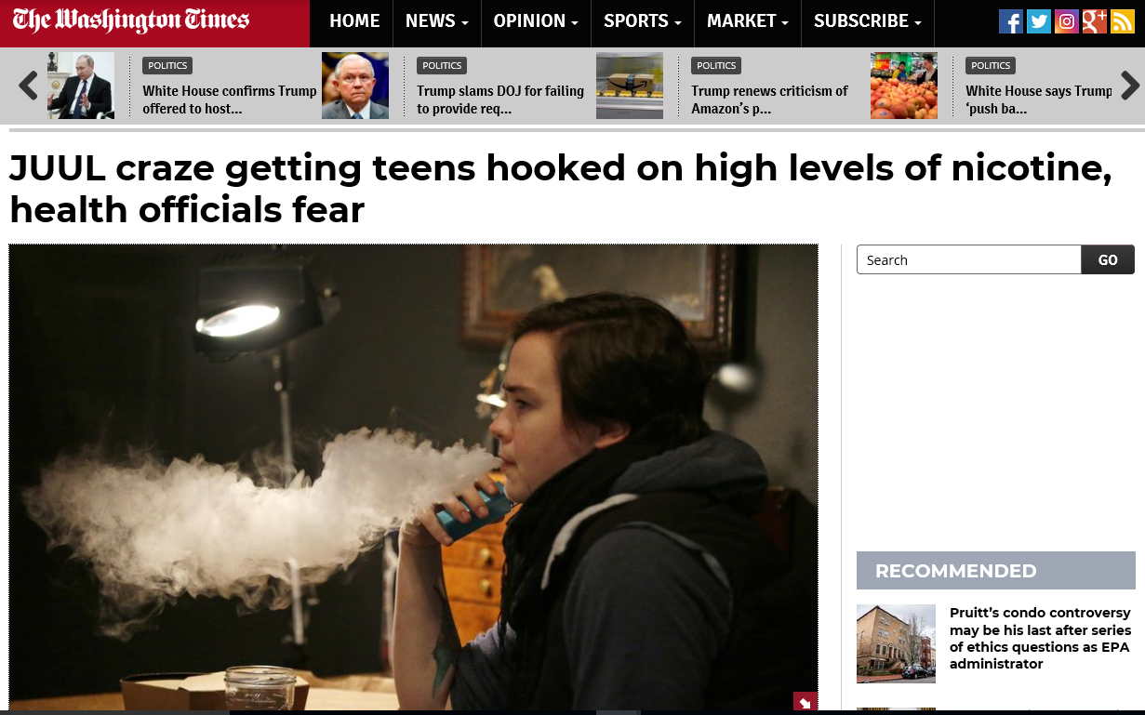
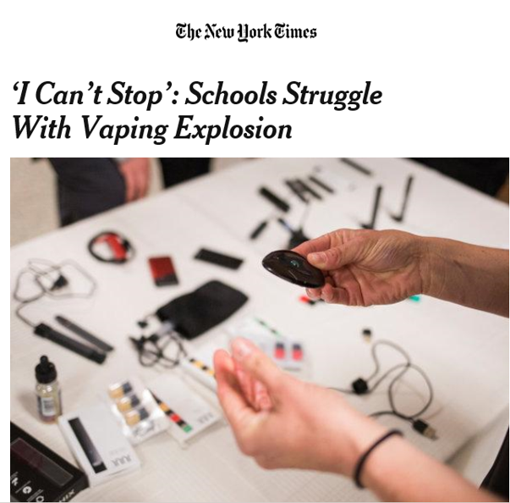
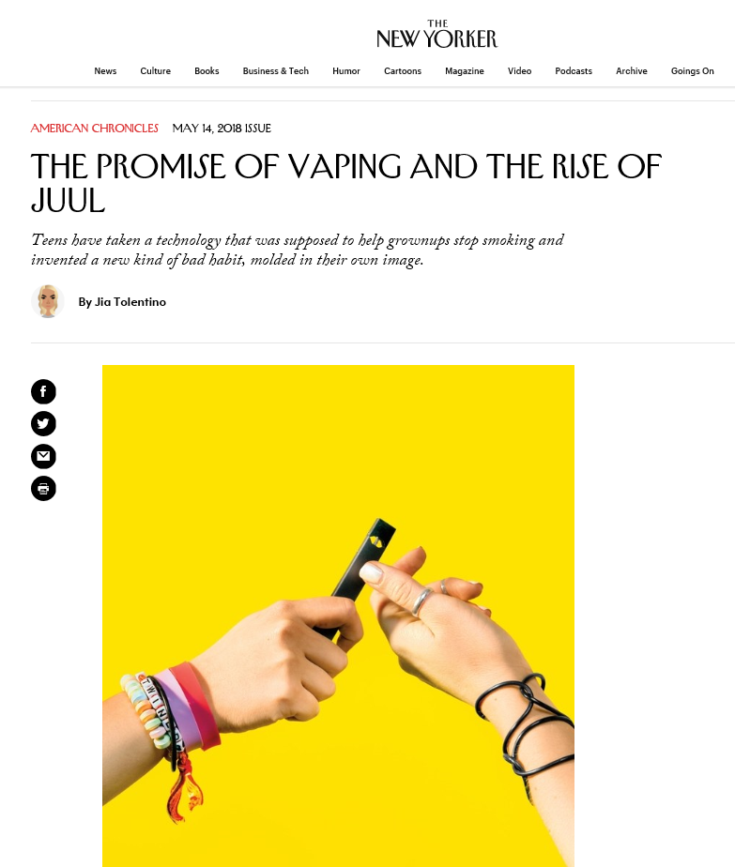
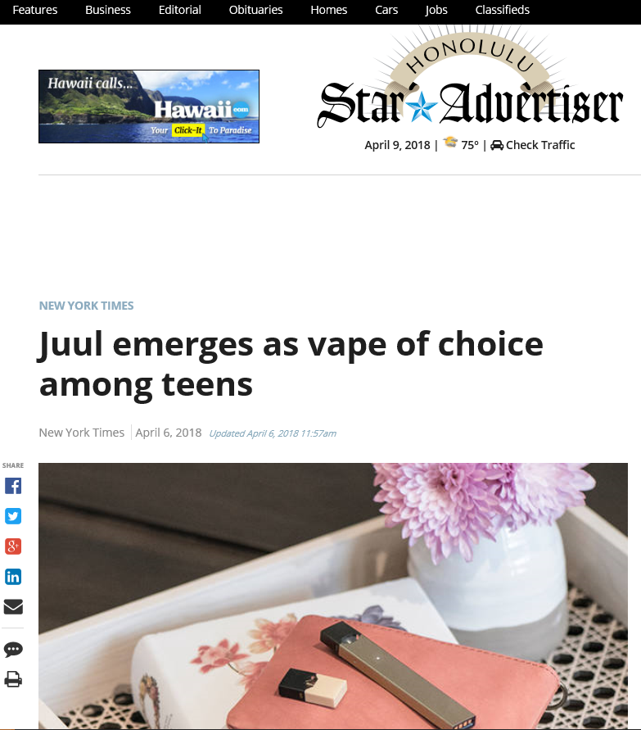
The Rise of JUUL

Slide 28
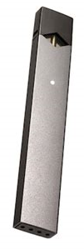
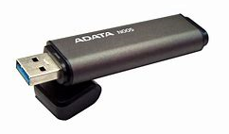
Nicotine
e-cigarettes (JUUL, MarkTen Elite)
Marijuana “vaporizer”
(Pax Era)
Actual USB Flash Drive

Slide 29
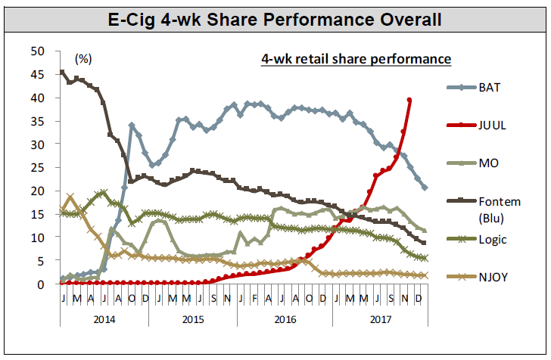
Top Selling E-cigarettes in the U.S.
Source: Nielsen Total US xAOC/Convenience Database and Wells Fargo Securities, LLC

Slide 30
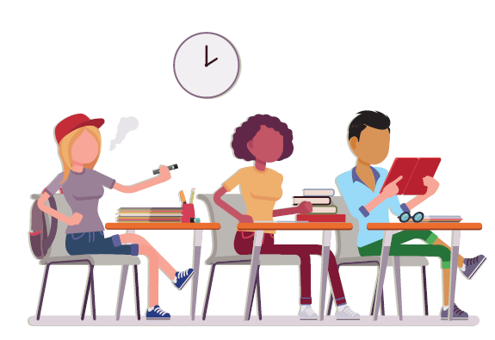
JUUL Use in School Bathrooms and Classrooms

Slide 31
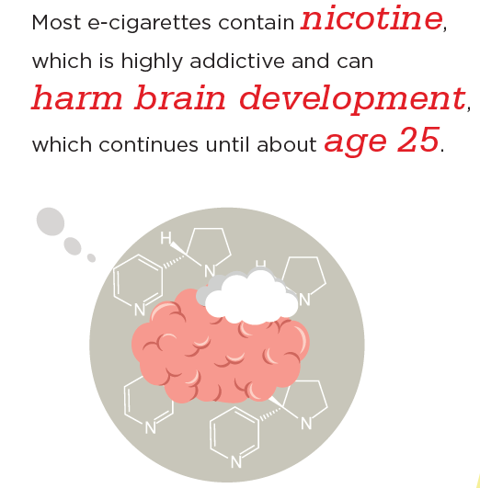
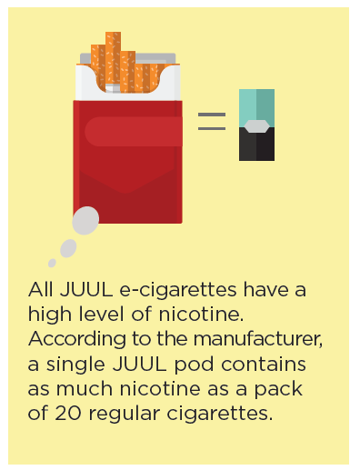
Tobacco Product Use in Any Form, Including E-cigarettes, is Unsafe for Youth

Slide 32
Most Tobacco Products Contain Free Base Nicotine
More volatile
Better able to pass through the blood/brain barrier
Allows for the delivery of nicotine more efficiently
Ammonia is used to extract liquid nicotine from tobacco leaves
Ammonia raises the pH of the nicotine, which then becomes free base nicotine

Slide 33
JUUL Contains Nicotine Salts
Nicotine for e-liquid begins as free base nicotine
Initial patent for JUUL nicotine salt technology obtained in 2015
To change to a nicotine salt, an e-liquid maker adds an acid to lower the pH – usually benzoic acid

Slide 34
Are Nicotine Salts More Satisfying?
Greatest potential benefit of nicotine salt e-liquids is that users may find them more satisfying than other e-liquids
Lower pH of nicotine salt allows those e-liquids to create less throat hit than free base nicotine e-liquids with similar strengths
Nicotine salt allows use of higher nicotine e-liquids with less irritation

Slide 35
1
Patterns of Use
2
JUUL
3
Heated Tobacco Products
4
Policy Options

Slide 36
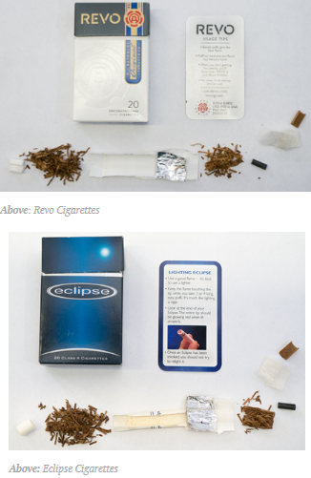
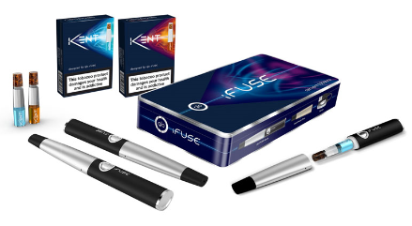
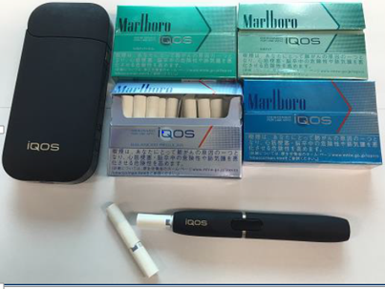
“Heat Not Burn” Products
Contain Tobacco
“Throat-Hit” similar to cigarettes
Positioned to appeal to smokers who have tried and rejected e-cigarettes

Slide 37
What Are “Heat Not Burn” Products?
Industry term to describe products that heat tobacco leaf to deliver an inhaled aerosol
Technology first introduced in the 1980s and 1990s – two primary formats:
Unclear whether combustion actually occurs; thus, use of the term “heated tobacco products” (HTPs)

Slide 38
Analog HTPs
Carbon tip heated with a lighter
User inhales 4-5 times before the tip glows red and product is activated
Packs of 20, similar size and shape of cigarette
3 iterations have tested in U.S. (1989 Premier, 1994-2005 Eclipse, 2015 Revo)

Slide 39
Electronic HTPs
Test marketing began in 1998 in Richmond, VA, discontinued in 2006 due to “lack of commercial success”
Battery powered “smoking system.” Heating blades pierce Accord cigarette. Device activated only when puffed.
Ads said Accord “produces a lot less smoke” but did not want to “disparage existing brands” in marketing

Slide 40
iQOS Up Close
Source: The Washington Post and Phillip Morris International

Slide 41
iQOS – Additional Platforms
Platform 1 – uses electronically controlled heating blade (razor/blade)
Platform 2 – “look & feel” of a cigarette, not electronic
Platform 3 – “nicotine-containing vapor via chemical reaction; no tobacco”
Platform 4 – “nicotine containing liquid heated electronically; no tobacco”
Source: PMI 2017 CAGNY presentation

Slide 42
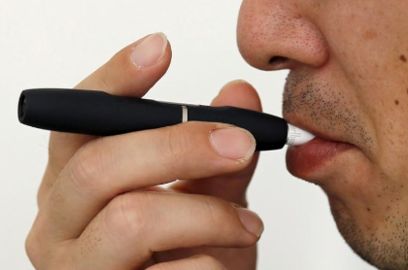
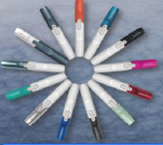
Pending FDA Pre-Market Approval
Philip Morris International submitted applications to FDA for approval to:
Make health claims (“Modified Risk Tobacco Product” application or MRTP)
A scientific advisory committee met to discuss the MRTP application in January 2018.
Market iQOS (“Premarket Tobacco Product Application” or PMTA)

Slide 43
Ever Use of Heat-Not-Burn
Products Among U.S. Adults, 2017
Source: Marynak et al. Awareness and Ever Use of “Heat-Not-Burn” Tobacco Products Among U.S. Adults, 2017. Am J Prev Med, 2018 [in press]

Slide 44
Industry and Financial Sector Statements
Our ambition is to lead a full-scale effort to ensure that noncombustible products ultimately replace cigarettes….
– PMI CEO Andre Calantzopoulos
Now we’ve made a dramatic decision… Indeed, our vision – for all of us at PMI – is that these products will one day replace cigarettes. Why are we doing this? Because we should… Society expects us to act responsibly. And we are doing just that by designing a smoke-free future. And because we now can.
– www.PMI.com
HTPs could displace up to 30% of the U.S. combustible cig industry by 2025 and increase smoking prevalence.
– Bonnie Herzog, Wells Fargo
PMI employee/model in lab coat, from www.pmi.com

Slide 45
Independent Studies Will Provide Critically Needed Information
One study found that heating tobacco between 100-200°C releases nicotine and some cigarette smoke compounds. Emissions increased with temperature.¹
Another study compared iQOS to a reference cigarette. VOCs, polycyclic aromatic hydrocarbons, and CO were present in iQOS smoke.²
¹ Forster M, Liu C, Duke MG, et al. An experimental method to study emissions from heated tobacco between 100–200 C. Chem Cent J 2015;9:20. 2 Auer R, Concha-Lozano N, Jacot-Sadowski I, Cornuz J, Berthet A. Heat-not-burn tobacco cigarettes: Smoke by any other name. JAMA Int Med. Published Online: May 22, 2017. doi:10.1001/jamainternmed.2017.1419

Slide 46
1
Patterns of Use
2
JUUL
3
Heated Tobacco Products
4
Policy Options

Slide 47
#7
Major Conclusion
“Action can be taken at the national, state, local, tribal, and territorial levels to address e-cigarette use among youth and young adults. Actions could include incorporating e-cigarettes into smoke-free policies, preventing access to e-cigarettes by youth, price and tax policies, retail licensure, regulation of e-cigarette marketing likely to attract youth, and educational initiatives targeting youth and young adults.”

Slide 48
Stakeholders Who Can Take Action
Teachers, coaches, and other youth influences
Civic and community leaders
Public health and health care professionals
Researchers
Federal government
State, local, tribal, and territorial governments
E-cigarette manufacturers, distributors, and retailers
Voluntary health agencies, non-governmental organizations, and other community and faith based organizations
Individuals, parents, and families

Slide 49
Call to Action: GOALS
1. First, Do No Harm
2. Provide information about the dangers of e-cigarette use among youth and young adults
3. Continue to regulate e-cigarettes at the federal level to protect public health
4. Programs and policies to prevent e-cigarette use among youth and young adults
5. Curb advertising and marketing that encourages youth and young adults to use e-cigarettes
6. Expand surveillance, research, and evaluation related to e-cigarettes

Slide 50
Public Health Actions to Address E-Cigarettes
Federal Regulation
Family Smoking Prevention and Tobacco Control Act
State, Local, Territory
Potential Sub-National Action:
Signed into law on June 22, 2009
Granted FDA the authority to regulate tobacco products
Enhances the ability to intensify policy to reduce tobacco industry influence
Manufacturing
Marketing
Sale
Including e-cigarettes in smokefree indoor air policies
Restricting youth access to e-cigarettes in retail settings
Licensing retailers
Establishing specific package requirements
Setting price policies

Slide 51
New FDA Manufacturer Requirements:
Registering manufacturing establishments and providing product listings to the FDA
Reporting ingredients, and harmful and potentially harmful constituents
Requiring premarket review and authorization of new tobacco products by the FDA
Placing health warnings on product packages and advertisements
Not marketing newly deemed tobacco products (including e-cigarettes)with modified risk claims unless authorized by the FDA.

Slide 52
Opportunities Exist to Modernize Our Proven Interventions……….
Tobacco 21
Smoke-free Multiunit Housing
Tobacco-free College
E-cigarettes
Tobacco-free Pharmacies
e-Referrals
Tobacco-free Sports
Digital Media

Slide 53
States With & Without Laws Prohibiting Smoking & Use of
E-cigarettes in Indoor Areas of Private Worksites, Restaurants, & Bars – U.S., December 2017
D.C
No Comprehensive Smoke-Free Law or Prohibition on Indoor E-cigarette Use
Prohibits Indoor Smoking Only
Prohibits Indoor Smoking and Indoor E-cigarette Use
Source: Centers for Disease Control and Prevention. STATE System. 2016.
Notes:
53
53
BK: Add T21 slide after this.

Slide 54
Including
with Statewide T21 laws
5
Source: Preventing Tobacco Addiction Foundation. http://tobacco21.org. Accessed April 13, 2018.

Slide 55
Takeaways
1
Youth use of tobacco products in any form, including electronic tobacco products, is unsafe.
2
Adult smokers must completely quit to realize benefits from e-cigarettes. E-cigarettes are not currently an FDA approved quit aid.
3
4
Recently, the electronic product landscape has diversified to include new products, including JUUL and heated tobacco products.
The tobacco product landscape continues to diversify, and it’s critical to modernize tobacco control strategies to adapt to these changes.

Slide 56
Brian A. King, PhD, MPH baking@cdc.gov
Office on Smoking and Health
www.cdc.gov/tobacco

